Slide 1
CVMS Provider Portal Vaccine Administration User Guide
Version 1.0
December 10, 2020
NC DHHS COVID – 19 Response

Slide 2
If you have any questions, please submit all inquiries to:
CVMS-Help@dhhs.nc.gov

Slide 3
Table of Contents
Pages
Vaccine Administration Overview and Process | 4 - 7
Enter & Submit Vaccine Administration Record | 8 – 17
Post-Vaccine Administration Reminders | 18 - 19
Appendix | 20 - 22

Slide 4
Vaccine Administration
Process Overview

Slide 5
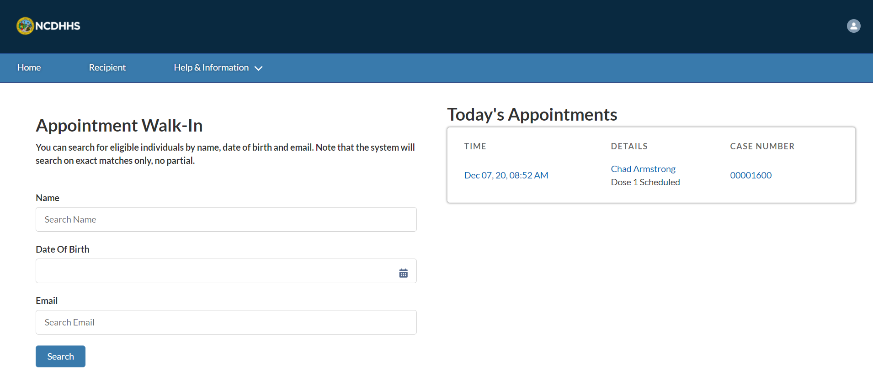
Overview
Administering the vaccine typically involves:
Recording the vaccine administration details
Understanding post-vaccine administration reminders
The processes included in this training are for the Healthcare Provider and Healthcare Location Manager profiles.
And lastly, you will need to:
Use the latest version of Chrome, Firefox, or Safari (Internet Explore will not be supported)
Log into your CVMS Provider Portal
Now, let’s get started!

Slide 6
CVMS On-Site Vaccine Administration
How will the Healthcare Provider administer the vaccine?
Key Objectives:
How to go through the Vaccine Administration process on-site
1
2
3
4
Recipient shows up to receive their vaccine.
The Healthcare Provider verifies recipient’s identity and eligibility using the Appointment Walk In Tool.
Healthcare Provider creates the Appointment Booking.
Healthcare Provider opens the Appointment Booking and begins Vaccine Administration process.
Healthcare Provider provides recipient with Emergency Use Authorization Fact Sheet.
Recipient receives vaccination.
Healthcare Provider enters vaccine administration information and submits vaccine administration record.
The Vaccine Administration process is now complete.
Healthcare Provider provides recipient with V-safe information sheet and a few reminders on second dosage reminder, proof of vaccination, and adverse event reporting.
Audience
Healthcare Provider
Healthcare Location Manager

Slide 7
Key Terms
EUA Fact Sheet
Under section 564 of the Federal Food, Drug, and Cosmetic Act, the FDA Commissioner may allow unapproved medical products or unapproved uses of approved medical products to be used in an emergency to diagnose, treat, or prevent serious or life-threatening diseases or conditions caused by CBRN threat agents when there are no adequate, approved, and available alternatives. This is known as Emergency Use Authorization.
Priority Tier
Since there will initially be a very limited supply of COVID-19 vaccines, North Carolina is implementing a risk-based prioritization approach based on guidance from the National Academy of Medicine, the CDC’s Advisory Committee Immunization Practice, and the NC Institute of Medicine. The NC population is divided into four priorities based on an individual’s occupation, medical history, and age.
The planned first phase contains health care workers at high risk of exposure to COVID-19 and Long-Term Care Facility staff and residents, followed by frontline workers and adults living in congregate settings (e.g., migrant farm or fisheries workers, homeless shelters residents, incarcerated individuals) that have two or more chronic health conditions or are 65 years or older, and staff of homeless shelters, prisons, and jails.
Eligibility
A recipient’s eligibility will initially be determined by two factors: 1) if the Priority Tier they fall under has been approved by the NC Department of Health and Human Services to receive the COVID-19 vaccine and 2) if they have not had COVID-19 in the past 30 days.
Vial
Vials are used to store vaccines intended for parenteral administration.
Dose
The quantity of COVID-19 vaccine to be administrated per usage.

Slide 8
Completing the Vaccine Administration Process
How do you document the vaccine administration process?

Slide 9
Step 1 of 9: Recipient Appointment Booking
When a RECIPIENT walks in to receive their vaccine, they will be checked in using the APPOINTMENT WALK IN TOOL on the home page.
The Healthcare Provider who checks them in will create an APPOINTMENT BOOKING for the recipient which will be available under TODAY’S APPOINTMENTS on the HOME PAGE.
Tasks
Check in recipient using appointment walk-in tool and create booking for recipient
Tips
Learn more about checking in a recipient into the CVMS Provider Portal Recipient Check-In User Guide
Audience
Healthcare Provider
Healthcare Location Manager

Slide 10
Step 2 of 9: Recipient Booking Information
When you are ready to begin the VACCINE ADMINISTRATION PROCESS, navigate to the HOME PAGE and find the CORRECT BOOKING. The appointment booking will initiate the vaccine administration process, where you will VERIFY THE RECIPIENT’S IDENTITY, REVIEW THEIR MEDICAL HISTORY, CAPTURE THE VACCINE DETAILS, and more.
On your home page, locate TODAY’S APPOINTMENTS
Click the CORRECT BOOKING for the recipient
Tasks
Locate the correct appointment booking
Tips
Make sure to click the correct recipient under Today’s Appointments
Audience
Healthcare Provider
Healthcare Location Manager

Slide 11
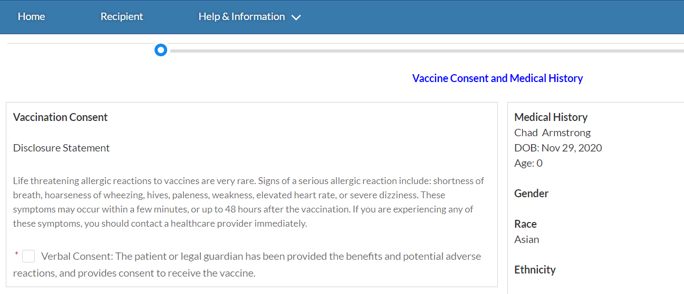
Step 3 of 9: Receive Verbal Consent
After clicking the appointment booking, you will see the VACCINE CONSENT page. Before administering the vaccine, VERBAL CONSENT IS REQUIRED.
Read the DISCLOSURE STATEMENT to the recipient
After you RECEIVE VERBAL CONSENT, you can CHECK the check box indicating that consent was provided
Click NEXT
Note: The recipient’s MEDICAL HISTORY will be displayed on the right-hand side of the screen.
Tasks
Acquire verbal consent from recipient and mark consent as completed
Tips
Read the text from the DISCLOSURE STATEMENT
Audience
Healthcare Provider
Healthcare Location Manager

Slide 12
Step 4 of 9: Provide the EUA Fact Sheet
Before you administer the vaccine, you must also PROVIDE the EMERGENCY USE AUTHORIZATION (EUA) FACT SHEET and the V-SAFE INFORMATION SHEET to the recipient or guardian.
1. Obtain copies of the EUA Fact Sheet at this website (There will be different EUAs for different vaccines): https://www.fda.gov/media/144414/download (Pfizer EUA)
2. Obtain copies of the V-SAFE Information Sheet at this website: https://immunize.nc.gov/providers/ncip/pdf/v_safe_poster_508.pdf
3. Provide the recipient or guardian with the EUA Fact Sheet prior to vaccination.
2. Ask the recipient if they have any questions about the risks and benefits of receiving the COVID-19 vaccine.
3. Counsel the recipient on the importance of enrolling in V-safe to report any adverse events following vaccination.
Tasks
Give Emergency Use Authorization Fact Sheet and V-safe Information Sheet to recipient
Tips
Counsel recipient on importance of V-safe reporting
Audience
Healthcare Provider
Healthcare Location Manager

Slide 13
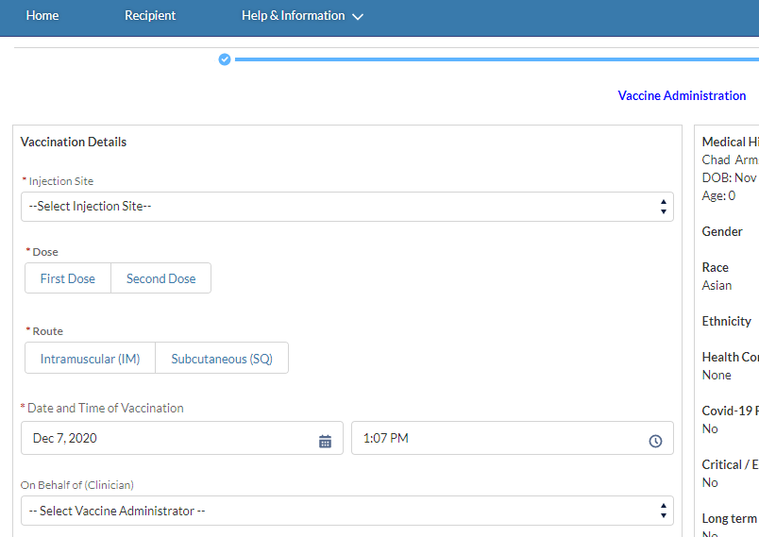
Step 5 of 9: Review the Vaccine Administration Details
Once you receive vaccine consent and provide the EUA Fact Sheet, you will continue to the VACCINE ADMINISTRATION page. This page is where you will CAPTURE KEY INFORMATION about the VACCINE ADMINISTERED and IMMEDIATE ADVERSE EFFECTS, if any.
Tasks
Record information about the administered vaccine
Tips
Make sure to look for and include any immediate adverse effects from the vaccine, if any arise
Audience
Healthcare Provider
Healthcare Location Manager

Slide 14
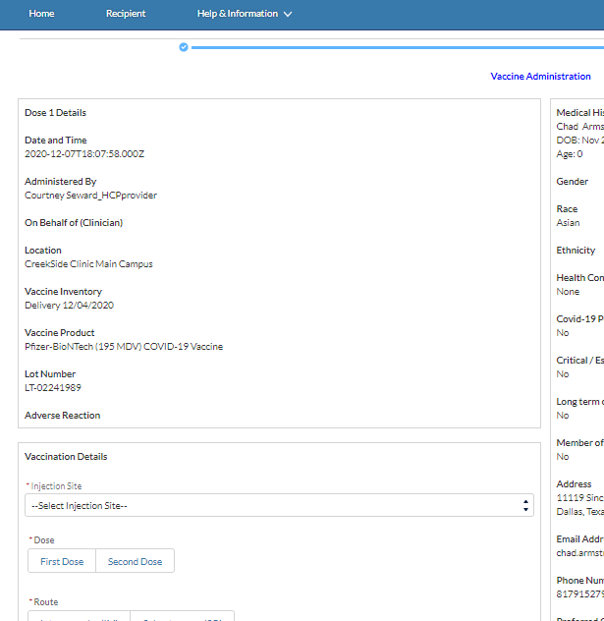
Step 6 of 9: Vaccine Administration Details for the Second Vaccine Dose
If your recipient RECEIVED THE FIRST DOSE (if applicable), you will see FIRST DOSE DETAILS at the TOP OF THE VACCINE ADMINISTRATION PAGE.
Dose 1 Details will include:
Date and Time
Administered By
On Behalf Of (Clinician)
Location
Vaccine Inventory
Vaccine Product
Lot Number
Adverse Reactions
Tasks
If recipient has received a prior dose, view the dose’s information on the Vaccine Administration page
Tips
Verify if a prior dose was given to the recipient
Audience
Healthcare Provider
Healthcare Location Manager

Slide 15
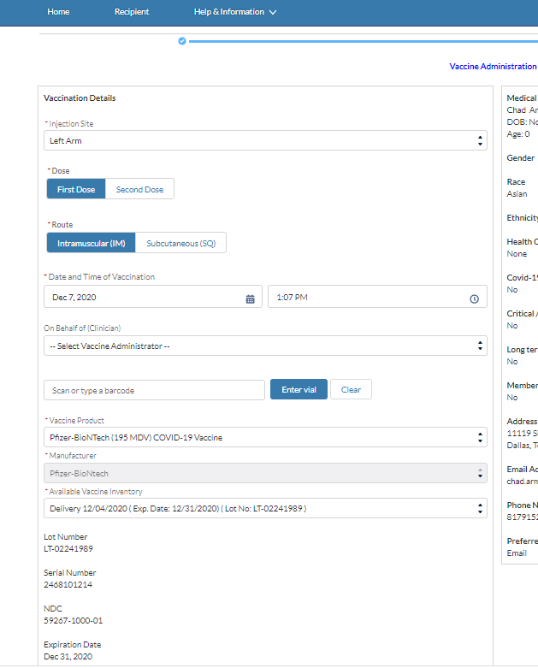
Step 7 of 9: Enter Vaccine Administration Details
On the VACCINE ADMINSTRATION page, you will capture all VACCINE DETAILS.
Populate all REQUIRED vaccination details
Injection Site
Dose
Route
Date & Time of Vaccination
Vaccine Product (Vaccine Type)
Available Vaccine Inventory (what lot?)
If you are administering a second vaccine dose, please be sure to confirm the vaccine is from the SAME MANUFACTURER as the first vaccine.
MANUFACTURER, LOT NUMBER, SERIAL NUMBER, NDC NUMBER and EXPIRATION DATE will AUTO POPULATE once you select the Product.
Note: If a field On Behalf Of (Clinician) appears, it is inferring you are entering information on behalf of another clinician who administered the vaccine
Tasks
Input all vaccine details from the dose to be administered
Tips
Verify all information before populating each field
Audience
Healthcare Provider
Healthcare Location Manager

Slide 16
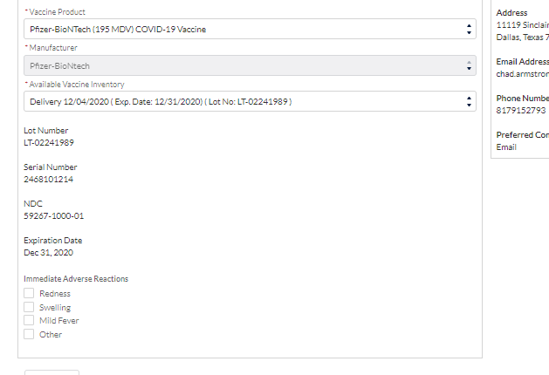
Step 8 of 9: Capture Immediate Adverse Reactions
If the recipient experiences any IMMEDIATE ADVERSE REACTIONS, capture those details on this page.
Select the IMMEDIATE ADVERSE REACTIONS that apply (ALL ARE OPTIONAL)
Redness
Swelling
Mild Fever
Other - If you selected Other a text box will appear. Write in any other immediate adverse effects that appear.
REVIEW ALL VACCINE DETAILS
Tasks
Observe recipient for any adverse reactions from the vaccine
Tips
Talk to the recipient about any adverse reactions they might be experiencing that might be overlooked
Audience
Healthcare Provider
Healthcare Location Manager

Slide 17
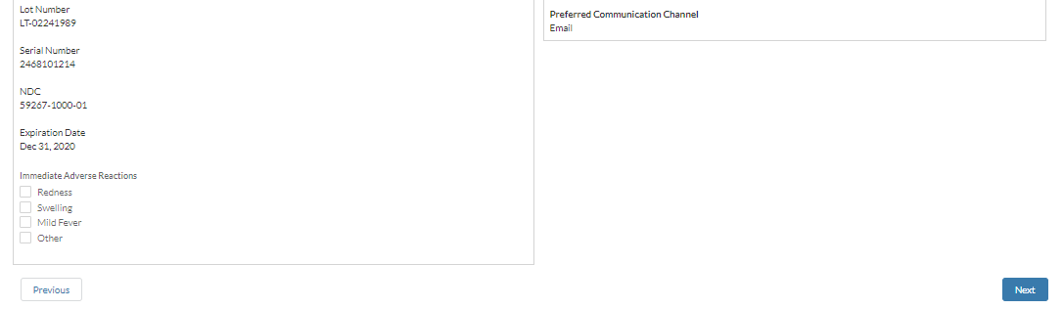
Step 9 of 9: Submit the Vaccine Administration Record
Before submitting the vaccine form, REVIEW that all details you entered are accurate. After clicking NEXT, you will be redirected to your home page.
See the next section for a few POST-APPOINTMENT REMINDERS.
Click NEXT.
The HOME PAGE will appear.
Tasks
Review and verify vaccine details entered and submit the Vaccine Administration Record
Tips
Take a second look at all fields populated
Audience
Healthcare Provider
Healthcare Location Manager

Slide 18
Post Vaccine Administration Reminders
What do you do after you administer the vaccine?

Slide 19
Step 1 of 1: Post Vaccine Administration Reminders
Once the VACCINE ADMINISTRATION IS COMPLETE and you submit the record, please SHARE a few REMINDERS with the recipient.
Your recipient will receive two SECOND DOSAGE REMINDER NOTIFICATIONS, the first reminder is 24 HOURS after and the second is ONE WEEK AFTER the first dosage is administered. It will be important to remind the recipient about the timing requirements for the second dosage, if applicable.
Your recipient will receive a PROOF OF VACCINATION NOTIFICATION instructing the recipient to access their vaccination details in the CVMS RECIPIENT PORTAL. The proof of vaccination page will be automatically generated for the recipient.
Upon request, a Healthcare Provider can also print the recipient’s PROOF OF VACCINATION after the vaccine has been administered. Steps to complete this task are found on the following Training Guide: CVMS Provider Portal Viewing Proof of Vaccination User Guide.
COVID-19 VACCINATION RECORD CARDS will be provided by the CDC as part of the vaccine ancillary kits. Healthcare Providers should provide a completed vaccination record card with accurate vaccine information (i.e., vaccine manufacturer, lot number, date of first dose administration, and second dose due date) to each recipient to ensure a basic vaccination record is provided. Healthcare Providers should encourage recipients to keep the card and take a picture of the vaccine card with their cell phone to remind them of the second dose due date.
Tasks
Share key information and reminders with recipient
Tips
Learn more about viewing a recipient’s proof of vaccination in the CVMS Provider Portal Viewing Proof of Vaccination User Guide
Audience
Healthcare Provider
Healthcare Location Manager

Slide 20
Appendix

Slide 21
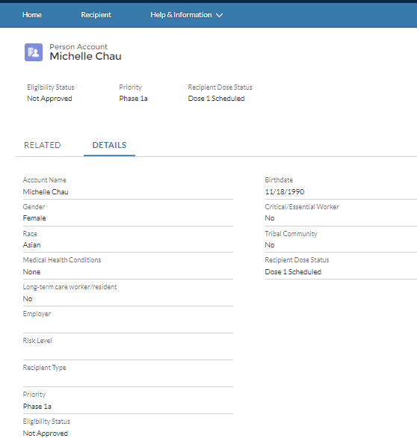
When the recipient is NOT Eligible for the Vaccine
When you verify RECIPIENT ELIGIBILITY, and the recipient is NOT APPROVED, you will need to inform the recipient that they will not be able to receive the vaccine at that time. ​
Tips:
You can review the recipient’s the Health Questionnaire Responses on the Recipient Record
A recipient is NOT ELIGIBLE to receive the vaccine if:
The do not have a registered CVMS Recipient Portal account
They are not approved to receive the vaccine
If the recipient informs you that their health information is NOT CORRECT, ask the recipient to UPDATE their recipient data in the CVMS RECIPIENT PORTAL.
You will NOT be able to EDIT the recipient’s profile.
From the home page, go to the RECIPIENT TAB
Search for the recipient in the ALL RECIPIENTS LIST VIEW
Click the RECIPIENT NAME
Click on DETAILS
Audience
Healthcare Provider
Healthcare Location Manager

Slide 22
Additional Notes
Key Items:
Hyperlinks appear as light blue and will provide additional information or navigation.
* Asterisks are used to denote required information.
A Toggle can be clicked to see selectable options.
A Pen can be clicked to make edits to the field.
Navigation Buttons can be clicked on to progress to the “next” or the “previous” step in a task.
A Pause button can be clicked if you wish to step away / and return to your form later. You will be prompted to review your previously entered data upon your return/ login.
Contact Information:
All questions should be directed to CVMS-help@dhhs.nc.gov.
Supported Web Browsers:
Please use the latest version of Chrome, Firefox or Safari to use this tool.
https://help.salesforce.com/articleView?id=getstart_browsers_sfx.htm&type=5
Note, Internet Explorer and Edge (Non-Chromium) will not be supported beginning January 2021.

