Slide 1
CVMS Provider Portal Receiving & Processing Vaccine Shipments User Guide
Version 1.0
December 10, 2020

Slide 2
If you have any questions, please submit all inquiries to:
CVMS-Help@dhhs.nc.gov

Slide 3
Table of Contents
Pages
Vaccine Inventory Management Overview and Process | 4 - 7
Receiving Vaccine Inventory Shipment Notification | 8 - 12
Adding Vaccine Inventory | 13 - 18
Receiving an Inbound Transfer | 19 - 23
Editing Vaccine Inventory Shipment Details | 24 - 27
Appendix | 28 - 29

Slide 4
Vaccine Inventory Management Overview
Process Overview

Slide 5
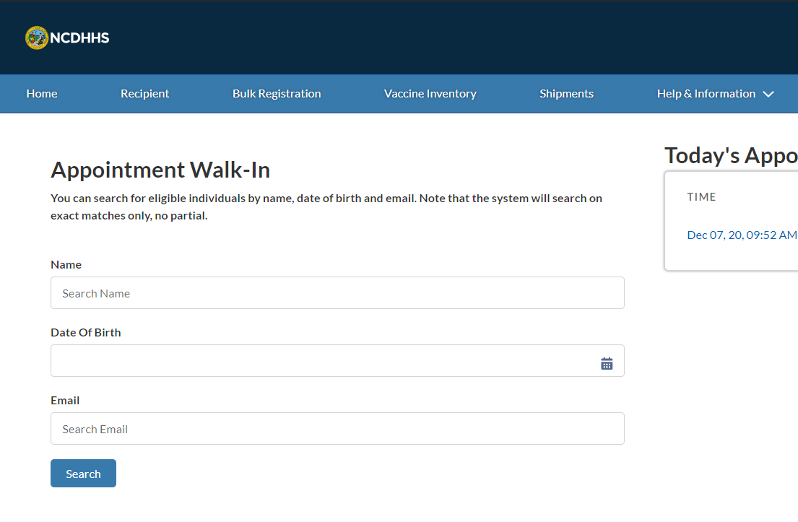
Overview
Receiving and processing vaccine inventory shipments typically involves:
Reviewing the vaccine inventory shipment record
Adding vaccine inventory
Adding inbound vaccine transfers
The processes included in this training are for Healthcare Location Managers.
Additionally, you will need to:
Use the latest version of Chrome, Firefox, or Safari
Log into the CVMS Provider Portal
Now, let’s get started!

Slide 6
Vaccine Inventory Process Overview (Receiving)
What should you do to properly track and report receiving vaccine inventory in CVMS?
Key Objectives:
How to review vaccine inventory records and add new vaccine inventory in CVMS
1
2
3
4
Log into the CVMS Provider Portal.
Identify if you’d like to review existing vaccine inventory and/or add additional vaccine inventory.
Once a vaccine inventory shipment is on its way, you will receive an email notification.
From the homepage, click to the Shipments page to review shipment information.
A list of shipments will be on the Shipments page.
You will be able to view on this page shipment information, including date shipped, quantity shipped, and tracking information.
You can also review shipment Lot #, NDC #, expiration date, and the manufacturer.
When you receive a vaccine shipment, you will add the inventory to your location’s overall vaccine inventory.
Navigate to the Vaccine Inventory tab and click add.
Enter all needed details into the prompted fields for the shipped vaccine inventory.
Review and save the inputted information.
Need to make updates to a vaccine shipment? You will only be able to make updates to the Total Inventory number.
Click into the vaccine inventory tab and click your desired shipment to make updates.
If additional corrections/updates need to be made, please contact the CVMS helpdesk (CVMS-help@dhhs.nc.gov).

Slide 7
Key Terms
Primary Location
Primary locations are the sites where vaccines are first shipped from the CDC.
Secondary Location
Secondary locations are the sites where vaccines are transferred from primary locations, rather than the CDC.
Vaccine Deprecation
Vaccine deprecation represents the process in which the amount of vaccines are reduced by the amount of vaccines administrated, wasted or returned.
NDC Code
National drug code is the unique 10-digit, 3-segment number found on each listed drug product that can identify the labeler, product and trade package size.
Order Record
Confirmation of the provider’s vaccine order (e.g., quantity, date).
Shipment Record
Tracking and confirmation of the vaccine shipment from the distributor to the provider.

Slide 8
Vaccine Inventory Shipment Notification
Where can you review expected vaccine inventory shipments?

Slide 9
Step 1 of 3: Navigate to Shipments
It is important to maintain accurate vaccine inventory levels for the location(s) that you support to remain in alignment with the CDC’s vaccine guidelines. Once a vaccine inventory shipment is on its way, a VACCINE SHIPMENT RECORD will be available for you to review in your SHIPMENTS TAB.
You will also receive an EMAIL NOTIFICATION when a VACCINE INVENTORY SHIPMENT is on its way to your location.
At the top of your home page, locate the SHIPMENTS TAB
Click SHIPMENTS
After clicking SHIPMENTS, you will be directed to the SHIPMENTS PAGE
Tasks
Click on Shipments Tab
Tips
You will be notified when a vaccine inventory shipment is on its way
Audience
Healthcare Location Manager

Slide 10
Step 2 of 3: Navigate to the Shipment Record
On this page, you will see a list of shipments for the location(s) you support. The VACCINE SHIPMENT RECORD will be RELATED to an ORDER RECORD. This means that your vaccine shipment record will always be associated to a specific order.
Locate the SHIPMENT ID
Click the SHIPMENT ID HYPERLINK
You will be directed to the VACCINE SHIPMENT RECORD
Tasks
Locate the vaccine shipment record
Tips
You can use the SEARCH BAR to search for a record. Clicking on column header will sort by the column
For example, you may choose to sort by SHIPMENT DATE
Audience
Healthcare Location Manager

Slide 11
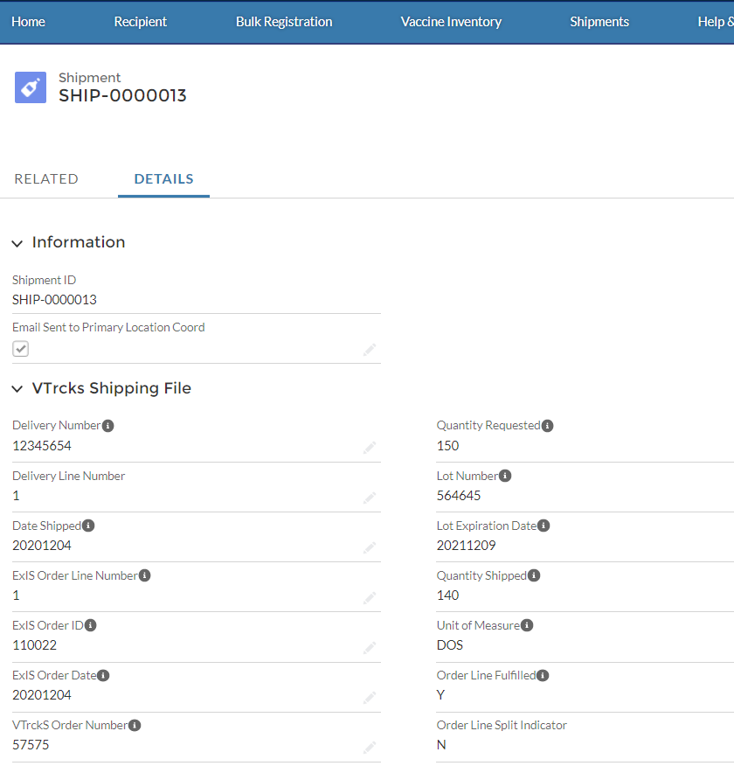
Step 3 of 3: Navigate to the Shipment Details
On the shipment record, you will be able to REVIEW DETAILS about your expected order including:
Date Shipped
Quantity Shipped
Tracking Information
Lot #
NDC #
Expiration Date
Manufacturer
On the shipment record, click on the DETAILS TAB
Tasks
Review shipment details
Tips
Review specific details about your order
Audience
Healthcare Location Manager

Slide 12
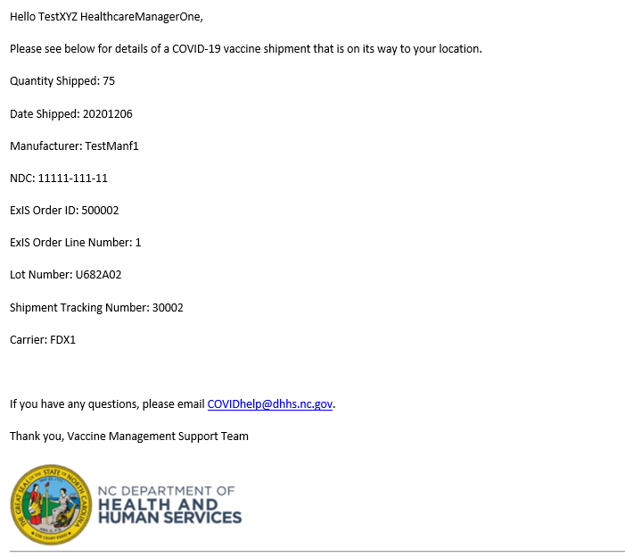
Vaccine Shipment Email Notification
Primary Vaccine Coordinators will be notified via EMAIL if a VACCINE SHIPMENT has been processed for location(s) they support. You can expect the email to come from the CVMS Support Team.
You will receive an email notification for each shipment BY VACCINE TYPE. Details in the email will include:
Provider PIN
Location Name
Date Shipped
Quantity Shipped
Manufacturer
VTrckS Order Number
Shipment Tracking Number
Carrier

Slide 13
Adding Vaccine Inventory
How do you process a new vaccine shipment?

Slide 14
Step 1 of 5: Navigate to the Vaccine Inventory tab
When you PHYSICALLY RECEIVE a vaccine inventory shipment, you will want to ADD THE INVENTORY to your location’s overall vaccine inventory. Processing your vaccine shipments correctly will ensure that your vaccine levels are accurate for your reporting.
This process DOES NOT include processing inbound vaccine inventory transfers. Please see the next section for steps on how to process inbound transfers.
At the top of your home page, locate the tab VACCINE INVENTORY​
Click VACCINE INVENTORY​
After clicking VACCINE INVENTORY, you will be directed to the VACCINE INVENTORY TAB
Tasks
Locate the vaccine inventory tab
Tips
Navigate to the vaccine inventory tab
Audience
Healthcare Location Manager

Slide 15
Step 2 of 5: Create a New Vaccine Inventory Record
At the top of the page, you will see the different actions you can take to manage your vaccine inventory. This will be your main working page for ensuring that your inventory levels are accurate. See the VACCINE INVENTORY WASTAGE, RETURNS & TRANSFERS TRAINING GUIDE to learn more about vaccine wastage, returns and transfers.
Click ADD
After clicking add, you will be prompted to PROVIDE ADDITIONAL VACCINE DETAILS
Tasks
Add a new vaccine inventory record
Tips
You can use the SEARCH BAR in the All Vaccine Inventories List View to search for a record
Clicking on COLUMN HEADER will sort by the column
Audience
Healthcare Location Manager

Slide 16
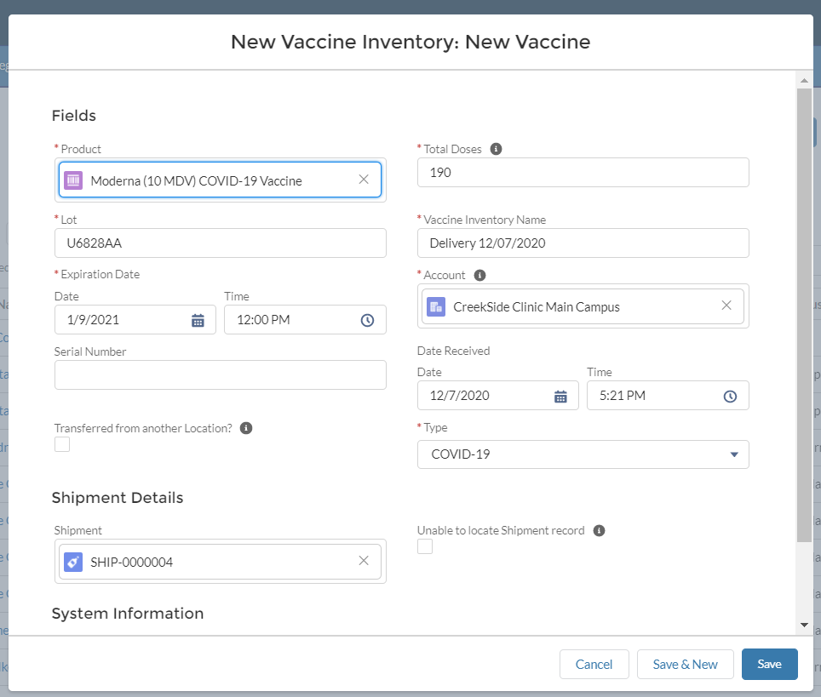
Step 3 of 5: Enter Vaccine Inventory Information
The NEW VACCINE INVENTORY PAGE will appear.
To search for a picklist value, you need to enter at least THREE CHARACTERS.
Populate all required VACCINE INVENTORY FIELDS
Product
Total Doses
Lot #
Vaccine Inventory Name (Editable)
Expiration Date
Account
Continue to SHIPMENT DETAILS
Tasks
Populate vaccine inventory information
Tips
Shipments from DIFFERENT LOT NUMBERS must be entered as separate inventory records
Audience
Healthcare Location Manager

Slide 17
Step 4 of 5: Enter Dosage & Shipment Details
You can now enter the remaining vaccine shipment details.
Do NOT reduce the TOTAL DOSES AMOUNT if you have wastage, spoilage, or plan to redistribute inventory.
This process MUST be recorded separately as INVENTORY DEPRECATION.
Select a SHIPMENT RECORD
If you cannot locate the shipment record, CHECK the UNABLE TO LOCATE SHIPMENT RECORD box
Before saving, REVIEW all entered details
Click SAVE
Tasks
Enter dosage and shipment details
Tips
You may click SAVE & NEW to add additional vaccine inventory
Audience
Healthcare Location Manager

Slide 18
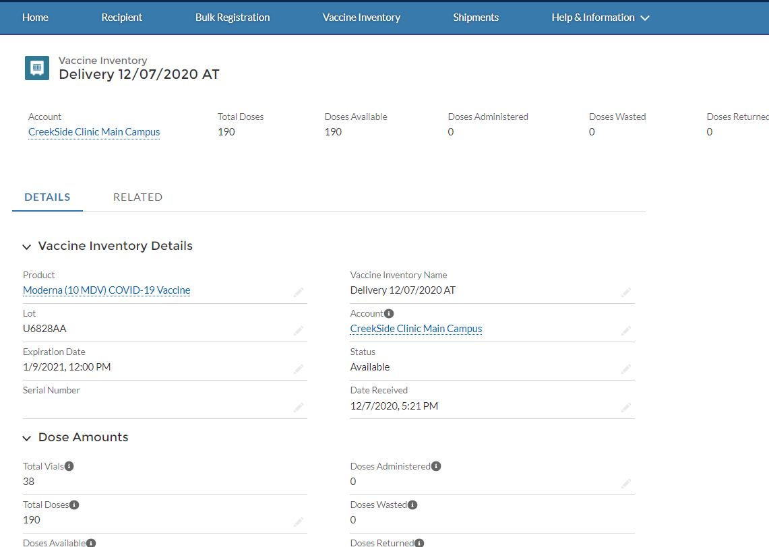
Step 5 of 5: Review the Vaccine Inventory Record
After clicking save, you will be directed to the VACCINE INVENTORY RECORD. Your vaccine inventory has now been updated to reflect this additional inventory.
At the top of the record, your VACCINE INVENTORY HIGHLIGHT PANEL will reflect ongoing DOSAGE ACTIVITY for this inventory.
Tasks
View vaccine inventory record
Tips
See your training curriculum to learn about the transfer, return, and waste vaccine inventory processes
Audience
Healthcare Location Manager

Slide 19
Receiving a Vaccine Transfer
How do you process an inbound transfer?

Slide 20
Step 1 of 4: Processing an Inbound Transfer
If you are RECEIVING an INBOUND TRANSFER from another location, you will want to review the inbound transfer page to stay up-to-date. When you receive the inbound transfer, you will be able to PROCESS THE INVENTORY via the INBOUND TRANSFER PAGE.
You DO NOT process inbound transfers from the ADD INVENTORY PROCESS.
From the home page, click VACCINE INVENTORY
Click INBOUND TRANSFER
Tasks
View inbound transfer
Tips
Inbound transfer is not processed from the Add Inventory Process
Audience
Healthcare Location Manager

Slide 21
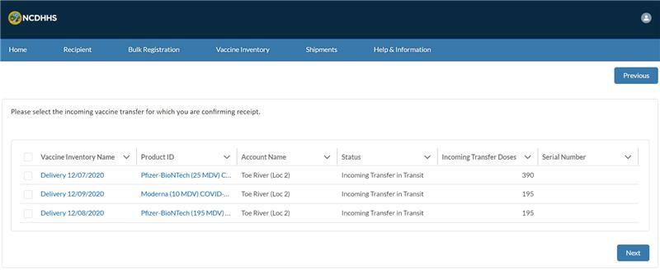
Step 2 of 4: Select the Vaccine inventory Record
On the INBOUND TRANSFER PAGE, you will see VACCINE INVENTORY records that are incoming transfers to your location. You will be able to select the inbound transfer you are ready to process and add it to your inventory.
Select the correct VACCINE INVENTORY record
Click NEXT
Tasks
Select the applicable inventory record for inbound transfer
Tips
Identify vaccine inventory records for inbound transfer
Audience
Healthcare Location Manager

Slide 22
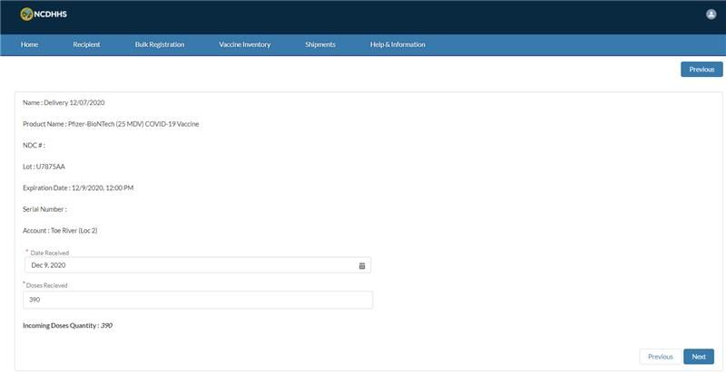
Step 3 of 4: Complete the Inbound Transfer form
Once you select the inventory, you will see the vaccine inventory details pre-populated. You will want to provide the DOSES RECEIVED and DATE RECEIVED.
After clicking next, your inventory levels will update, and the inbound transfer is now processed.
Enter the DATE RECEIVED
Enter the DOSES RECEIVED
Click NEXT
Tasks
Enter doses received and date received to process inbound transfer
Tip
Identify doses received and date received for the vaccine inventory
Audience
Healthcare Location Manager

Slide 23
Step 4 of 4: Complete the Inbound Transfer form
After clicking next, your inbound transfer is processed and added to your inventory.
Click FINISH
Tasks
Finish inbound transfer
Tip
Complete the inbound transfer form
Audience
Healthcare Location Manager

Slide 24
Updating Vaccine Inventory Details
How do you modify a vaccine inventory record?

Slide 25
Step 1 of 3: Navigate to the Vaccine Inventory tab
You will ONLY be able to update the VACCINE INVENTORY NAME on the vaccine inventory record. It will be very important to ensure accurate data entry when processing a new vaccine inventory shipment.
If you need to make ADDITIONAL CORRECTIONS to the vaccine inventory record, you will need to contact the CVMS HELPDESK.
The CVMS helpdesk can be reached at CVMS-help@dhhs.nc.gov
At the top of your home page, locate the VACCINE INVENTORY​ tab
Click VACCINE INVENTORY​
After clicking VACCINE INVENTORY, you will be directed to the VACCINE INVENTORY TAB
Tasks
Locate the vaccine inventory tab
Tips
Vaccine quantity will change through other actions, such as administration, wastage events, returns, or transfers
Audience
Healthcare Location Manager

Slide 26
Step 2 of 3: Navigate to Vaccine Inventory Record
Use the All Vaccine Inventories List View to locate the specific record you need to update. You can SEARCH or SORT in the list view.
Identify the VACCINE INVENTORY RECORD that you wish to update
Click the VACCINE INVENTORY NAME HYPERLINK
Tasks
Locate the specific vaccine inventory record to update
Tips
You can select the drop-down LIST VIEW MENU to see your RECENTLY VIEWED vaccine records
Audience
Healthcare Location Manager

Slide 27
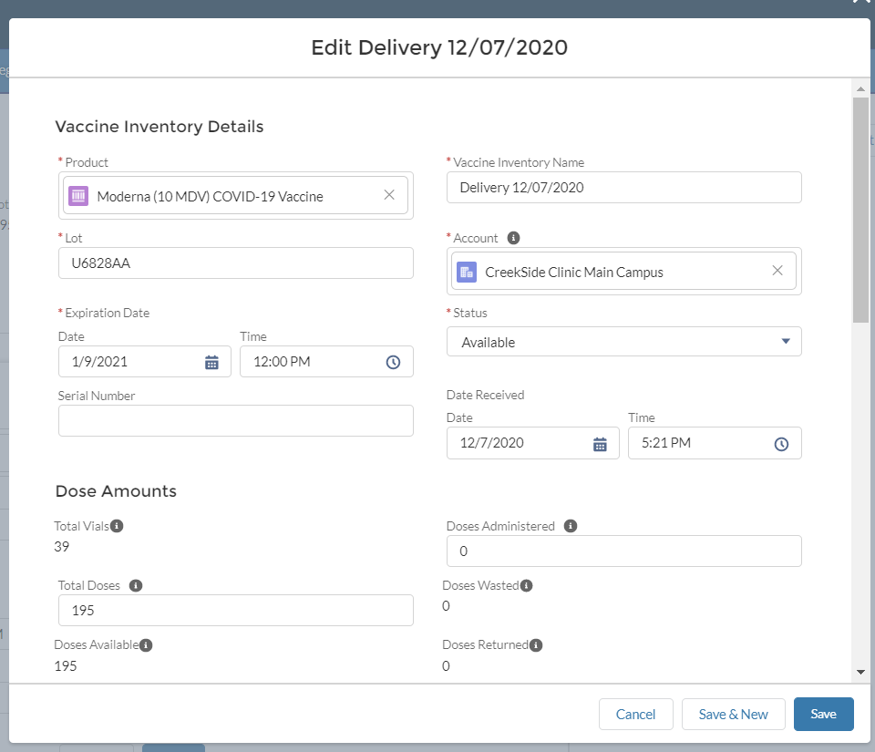
Step 3 of 3: Update the Vaccine Inventory Record
Before you edit, make sure you are on the appropriate record.
Remember, you must always save your changes.
Click the EDIT BUTTON on the right-hand side
Locate VACCINE INVENTORY NAME
Update the field
Click SAVE
If the field does not update, click REFRESH and try again
Tasks
Update the appropriate vaccine inventory record
Tip
Identify vaccine inventory name
Audience
Healthcare Location Manager

Slide 28
Appendix

Slide 29
Additional Notes
Key Items:
Hyperlinks appear as light blue and will provide additional information or navigation.
* Asterisks are used to denote required information.
A Toggle can be clicked to see selectable options.
A Pen can be clicked to make edits to the field.
Navigation Buttons can be clicked on to progress to the “next” or the “previous” step in a task.
A Pause button can be clicked if you wish to step away / and return to your form later. You will be prompted to review your previously entered data upon your return/ login.
Contact Information:
All questions should be directed to CVMS-help@dhhs.nc.gov.
Supported Web Browsers:
Please use the latest version of Chrome, Firefox or Safari to use this tool.
https://help.salesforce.com/articleView?id=getstart_browsers_sfx.htm&type=5
Note, Internet Explorer and Edge (Non-Chromium) will not be supported beginning January 2021.

