Slide 1
CVMS Provider Portal Log In and Getting Started User Guide
Version 1.0
December 10, 2020

Slide 2
If you have any questions, please submit all inquiries to:
CVMS-Help@dhhs.nc.gov

Slide 3
Table of Contents
Pages
Process Overview | 4 - 5
Log In to CVMS Provider Portal | 6 - 9
Provider Location Manager: Navigate CVMS Provider Portal | 10 - 15
Healthcare Provider: Navigate Healthcare Provider Portal | 16 - 18
Appendix | 19 - 21

Slide 4
Log in and Getting Started with the CVMS Provider Portal

Slide 5
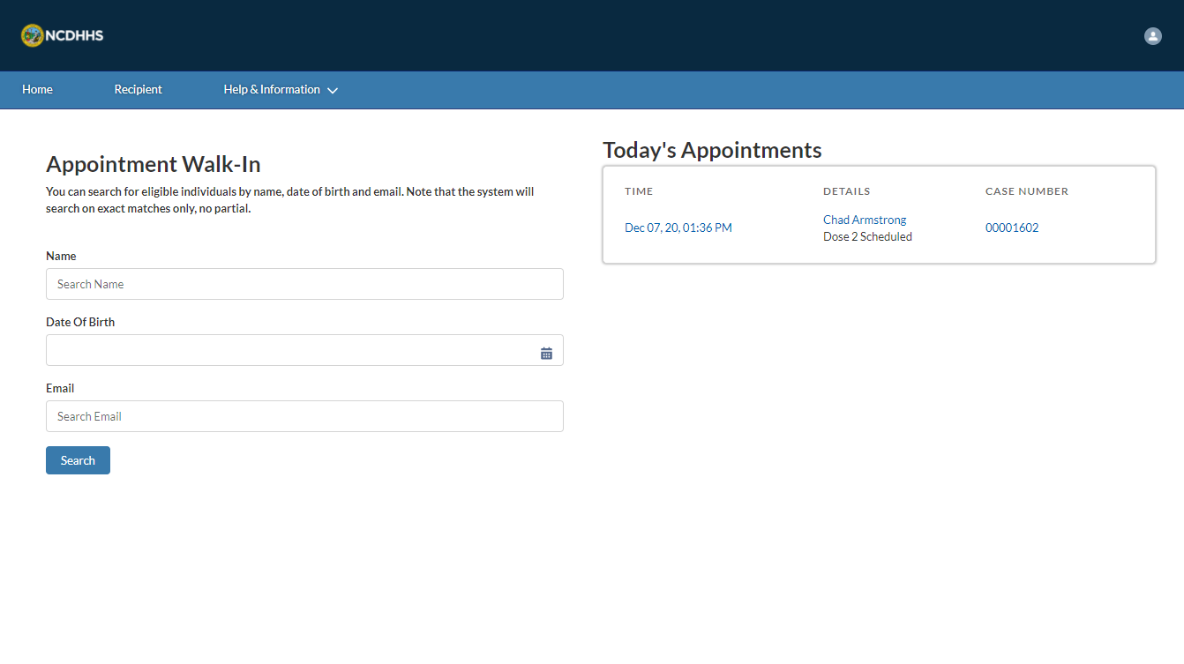
Overview
The CVMS Provider Portal allows Healthcare Providers in North Carolina to manage the administration of the COVID-19 vaccine.
This portal is different from the CVMS Provider Enrollment Portal, where Healthcare Providers enrolled for approval to administer the COVID-19 vaccine.
When logging in to the CVMS Provider Portal, be sure to have your NCID and NCID password available. If you do not have an NCID, refer to the Appendix for instructions on how to create one.
The processes included in this training are for the profiles Healthcare Location Manager and Healthcare Provider.
Additionally, you will need to:
Use the latest version of Chrome, Firefox, or Safari (Internet Explore will not be supported)
Now, let’s get started!

Slide 6
Log In to the CVMS Provider Portal
How do I log in to the CVMS Provider Portal?

Slide 7
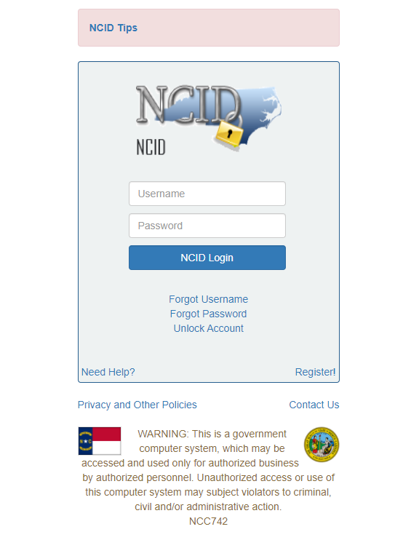
Step 1 of 3: Enter NCID and NCID Password
The link to the CVMS Provider Portal will open an NCID Log-In Screen
Enter your NCID and NCID PASSWORD
Click NCID LOGIN
You are logged in to the CVMS Provider Portal
For guidance on obtaining an NCID, refer to the Appendix.
Tasks
Log into CVMS Provider Portal
Tips
Remember your NCID and password
Your NCID must be linked to your profile prior to your first log in. Contact your Organization Administrator for CVMS to request to be added to CVMS
Audience
Healthcare Provider
Healthcare Location Manager

Slide 8
Step 2 of 3: View the CVMS Provider Portal Tabs
In the CVMS Provider Portal, TABS help you navigate between pages. The TABS you see are based on your user profile, Healthcare Location Manager or Healthcare Provider.
Healthcare Location Managers have the tabs shown below: Home, Recipient, Bulk Registration, Vaccine inventory, Shipments and HELP & INFORMATION
2. Healthcare Providers have the tabs shown below: Home, Recipient, and help & information
Tasks
Explore the Homepage
Tips
Learn more about managing your recipient’s appointments in the CVMS Provider Portal Recipient Check-In User Guide
Audience
Audience
Healthcare Provider
Healthcare Location Manager

Slide 9
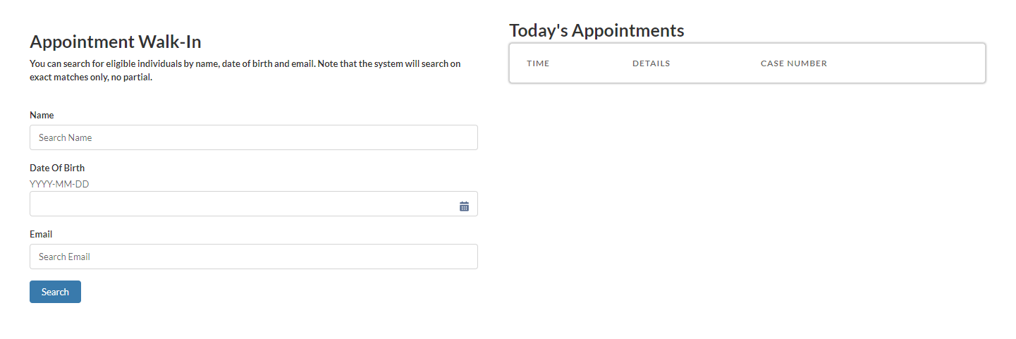
Step 3 of 3: View the CVMS Provider Portal Homepage
On the left side of the Homepage, you see APPOINTMENT WALK-IN, and on the right-side Today’s Appointments.
Please note that the Date of Birth will be displayed as follows: Year – Month – Day.
Audience
Audience
Healthcare Provider
Healthcare Location Manager

Slide 10
Healthcare Location Manager:
Navigate the CVMS Provider Portal
How do I navigate the CVMS Provider Portal as a Healthcare Location Manager?

Slide 11
Step 1 of 5: Recipient Tab Overview
Tasks
View Recipient tab
Tips
Learn more about managing your recipients in the CVMS Provider Portal Recipient Check-In User Guide
The Recipient tab shows a list of recipients at your location
Click the recipient’s name to view their account
Click the header for the field column you want to sort by. An arrow appears indicating how the list is sorted: from the column’s first record (alphanumerically) or its last (Down Sort icon).
Type your query into the search bar and press Enter. Click in the bar to check which fields are searchable.
Click the PRINTABLE VIEW button to open a list of recipients’ printable page
Audience
Healthcare Location Manager

Slide 12
Step 2 of 5: Bulk Registration Tab Overview
Tasks
View Bulk Registration tab
Tips
Learn more about uploading your staff information in the CVMS Provider Portal Recipient Bulk Upload User Guide
The Bulk REGISTRATION tab allows you to upload a list of employees and generate their invitation to register in CVMS to receive a COVID-19 vaccine.
Note: This tab will only be available if you have the Healthcare Location Manager profile.
Audience
Healthcare Location Manager

Slide 13
Step 3 of 5: Vaccine Inventory Tab Overview
Tasks
View Vaccine Inventory tab
Tips
Learn more about administrating your COVID-19 vaccine inventory in the CVMS Provider Portal Vaccine Inventory Wastage, Returns & Transfers User Guide
The Vaccine Inventory tab is used to manage your COVID-19 vaccine inventory
To pin a list view, click . The pinned list view will then load as the default list view.
Click the header for the field column you want to sort by. An arrow appears indicating how the list is sorted: from the column’s first record (alphanumerically) or its last (Down Sort icon).
Type your query into the search bar and press Enter. Click in the bar to check which fields are searchable.
Note: This tab will only be available if you have the Healthcare Location Manager profile.
Audience
Healthcare Location Manager

Slide 14
Step 4 of 5: Shipments Tab Overview
Tasks
View Shipments tab
Tips
Learn more about administrating your COVID-19 vaccine inventory in the CVMS Provider Portal Receiving & Processing Vaccine Inventory Shipments User Guide
The SHIPMENTS tab allows you to see your location’s COVID-19 vaccine shipment information
To pin a list view, click . The pinned list view will then load as the default list view.
Click the header for the field column you want to sort by. An arrow appears indicating how the list is sorted: from the column’s first record (alphanumerically) or its last (Down Sort icon).
Type your query into the search bar and press Enter. Click in the bar to check which fields are searchable.
Note: This tab will only be available you have the Healthcare Location Manager profile.
Audience
Healthcare Location Manager

Slide 15
Step 5 of 5: Help and Information Tab Overview
Tasks
View Help & Information tab
Tips
Learn more about finding support in the CVMS Provider Portal Accessing Help Resources User Guide
The Help & information tab allows you to see Frequently Asked Questions and General Information about the CVMS Provider Portal.
Audience
Healthcare Location Manager

Slide 16
Healthcare Provider:
Navigate the CVMS Provider Portal
How do I navigate the CVMS Provider Portal as a Healthcare Provider?

Slide 17
Step 1 of 2: Recipient Tab Overview
Tasks
View Recipient tab
Tips
Learn more about managing your recipients in the CVMS Provider Portal Recipient Check-In User Guide
The Recipient tab shows a list of recipients at your location
Click the RECIPIENT’s name to view their account.
Click the header for the field column you want to sort by. An arrow appears indicating how the list is sorted: from the column’s first record (alphanumerically) or its last (Down Sort icon).
Type your query into the search bar and press Enter. Click in the bar to check which fields are searchable.
Click the PRINTABLE VIEW button to open a list of recipients’ printable page.
Audience
Healthcare Provider

Slide 18
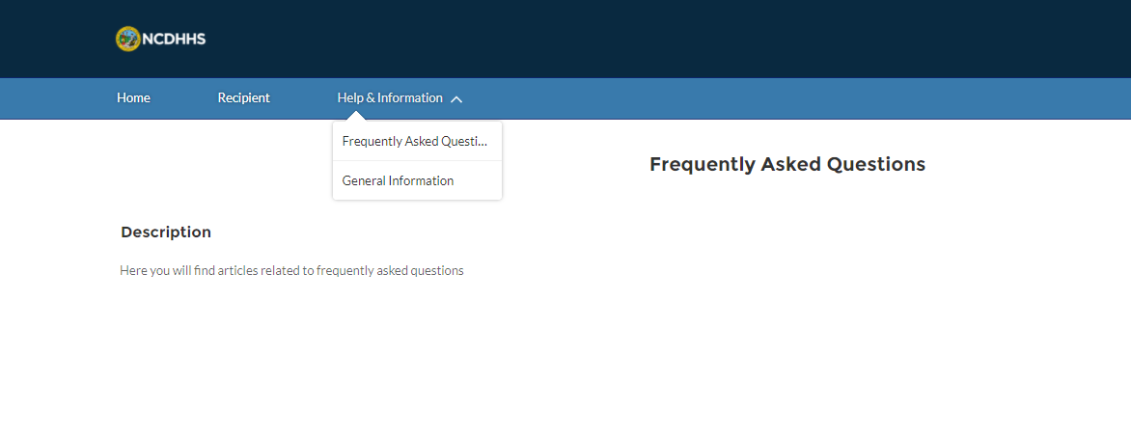
Step 2 of 2: Help and Information Tab Overview
Tasks
View Help & Information tab
Tips
Learn more about finding support in the CVMS Provider Portal Help Resources User Guide
Within the HELP & INFORMATION tab, you can see Frequently Asked Questions about the CVMS Provider Portal.
Audience
Healthcare Provider

Slide 19
Appendix

Slide 20
Additional Notes
Key Items:
Hyperlinks appear as light blue and will provide additional information or navigation.
* Asterisks are used to denote required information.
A Toggle can be clicked to see selectable options.
A Pen can be clicked to make edits to the field.
Navigation Buttons can be clicked on to progress to the “next” or the “previous” step in a task.
A Pause button can be clicked if you wish to step away / and return to your form later. You will be prompted to review your previously entered data upon your return/ login.
Contact Information:
All questions should be directed to CVMS-Help@dhhs.nc.gov.
Supported Web Browsers:
Please use the latest version of Chrome, Firefox or Safari to use this tool.
https://help.salesforce.com/articleView?id=getstart_browsers_sfx.htm&type=5
Note, Internet Explorer and Edge (Non-Chromium) will not be supported beginning January 2021.

Slide 21
How to Obtain an NCID
Instructions for a user to create an NCID:
Navigate to https://ncid.nc.gov/
Click Register! (in the bottom right corner of the blue box)
Click Business user type option
Complete the required fields to create an NCID
Follow the steps to access your NCID account and create your security questions
Once created, you will need to provide your NCID username to the designated Vaccine Coordinator for your location so they can request access to CVMS for you.
Once access has been granted by NC DHHS, the Vaccine Coordinator for your location should notify you that you are able to log in to the CVMS Provider Portal.
If you have any questions or need assistance in identify the Vaccine Coordinator for your location, please submit all inquiries to: CVMS-Help@dhhs.nc.gov

