Slide 1
CVMS Provider Portal Recipient Check-In User Guide
Version 1.0
December 10, 2020
NC DHHS COVID – 19 Response

Slide 2
If you have any questions, please submit all inquiries to:
CVMS-Help@dhhs.nc.gov

Slide 3
Table of Contents
Pages
Recipient Check In Overview & Process | 4 – 7
Verify Recipient Identity & Vaccination Eligibility | 8 - 14
Appendix | 15 - 17

Slide 4
Recipient Check-In at Front-Desk
Process Overview

Slide 5
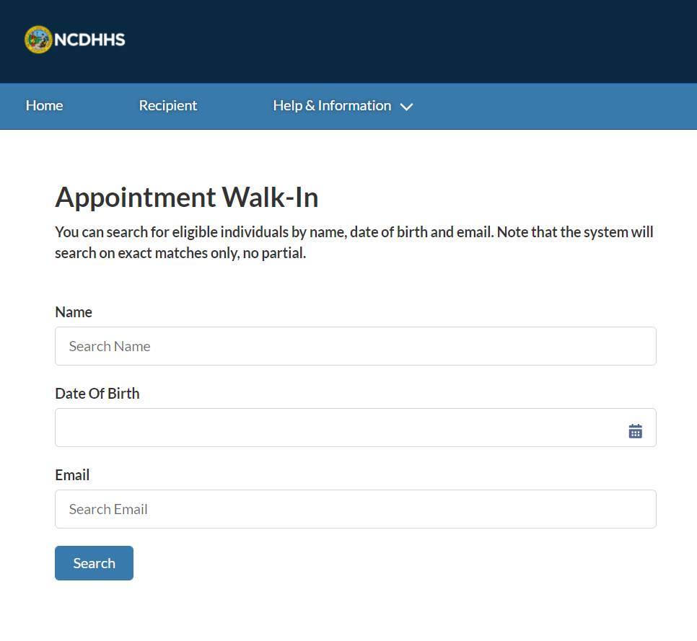
Overview
The Recipient Check-In process typically involves:
Verifying the recipient’s identity
Verifying their eligibility to receive the vaccine
Checking the recipient in as a Walk-In
It is important to note that for a recipient to receive the vaccine, they must be REGISTERED IN CVMS and approved (ELIGIBLE TO RECEIVE THE VACCINE).
This set of activities can be performed by a Healthcare Location Manager or Healthcare Provider.
You will also need to:
Use the latest version of Chrome, Firefox, or Safari, and
Log into your HCP portal
Now, let’s get started!

Slide 6
Checking In a Recipient in the CVMS Provider Portal
Time Estimate
Recipient check in takes less than 10 minutes to complete
1
2
3
4
5
Healthcare Provider (HCP) initiates the check-in process using the Appointment Walk-in Tool
HCP searches recipient’s name, DOB or email address
HCP locates the correct recipient record
HCP confirms recipient identity details with recipient
HCP confirms that recipient is eligible to receive vaccine
Key Objectives
How to check in a recipient identity
HCP creates appointment booking for recipient
6
Healthcare Provider
Healthcare Location Manager

Slide 7
Key Terms
Since there will initially be a very limited supply of COVID-19 vaccines, North Carolina is implementing a risk-based prioritization approach based on guidance from the National Academy of Medicine, the CDC’s Advisory Committee Immunization Practice, and the NC Institute of Medicine. The NC population is divided into four priorities based on an individual’s occupation, medical history, and age.
The planned first phase contains health care workers at high risk of exposure to COVID-19 and Long-Term Care Facility staff and residents, followed by frontline workers and adults living in congregate settings (e.g., migrant farm or fisheries workers, homeless shelters residents, incarcerated individuals) that have two or more chronic health conditions or are 65 years or older, and staff of homeless shelters, prisons, and jails.
Priority Tier
A recipient’s Eligibility status is determined by the Priority Tier they fall under as determined by the NC Immunization Branch. Eligibility requirements may be adjusted in the future by the NC Immunization Branch
Eligibility

Slide 8
Recipient Check-In
How do you check-in a recipient to receive the vaccine?

Slide 9
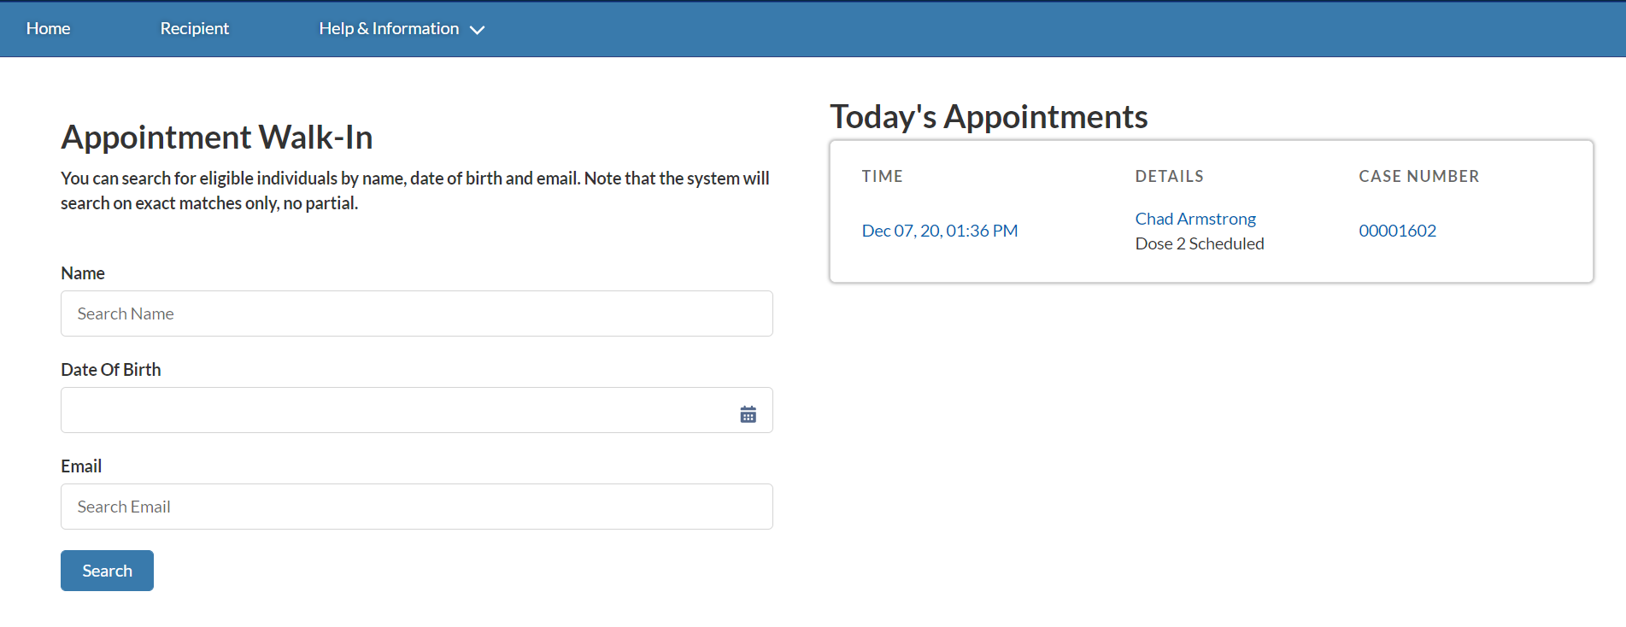
Step 1 of 6: Navigate to the CVMS Provider Portal Home Page
From the HOME PAGE, you will complete a simple CHECK-IN PROCESS using the Appointment Walk-in Tool on your home page before the recipient receives the vaccine.
Tasks
Check-in the recipient
Tips
You will NOT be able to schedule vaccine appointments in advance for recipients
Audience
Healthcare Provider
Healthcare Location Manager

Slide 10
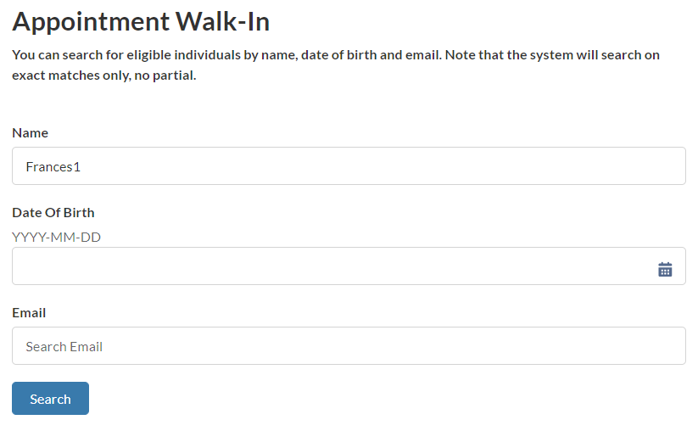
Step 2 of 6: Search for the Recipient
To get started, you will search for the RECIPIENT to help you IDENTIFY and CONFIRM ELIGIBILITY before creating their appointment.
A recipient cannot be checked in to receive the vaccine if they are not registered in the CVMS Recipient Portal.
Enter the recipient’s NAME, DATE OF BIRTH and / or EMAIL ADDRESS in the Appointment Walk-in Tool located on the Home Page
Only one field is required to search
Click SEARCH
Tasks
Search for the Recipient
Tips
To narrow your recipient search results, you can enter all search fields to help you find the recipient faster
Audience
Healthcare Provider
Healthcare Location Manager

Slide 11
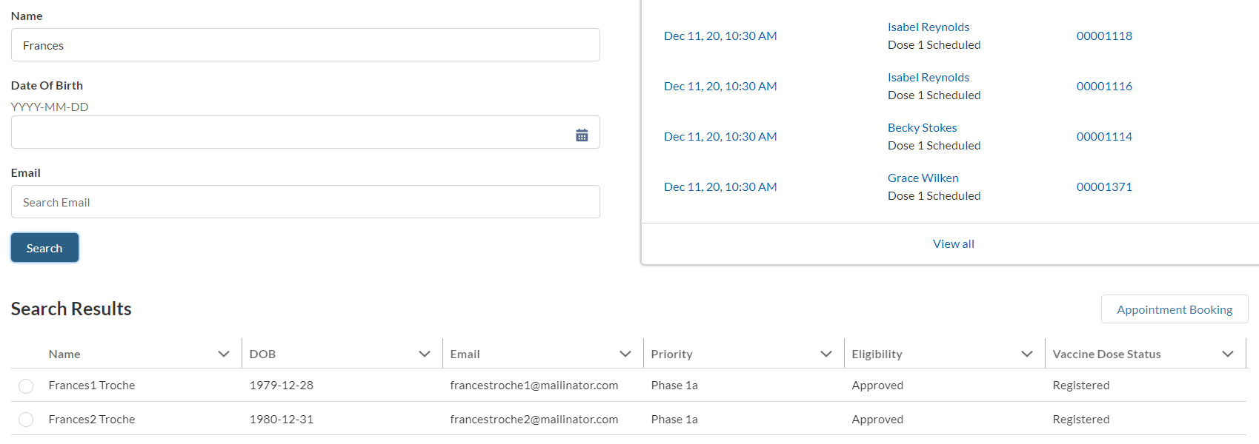
Step 3 of 6: Verify the Recipient’s Identity
After clicking search, you will see your RECIPIENT SEARCH RESULTS populate underneath the appointment walk in tool. You will be able to view the recipient’s NAME, DATE OF BIRTH, EMAIL, PRIORITY TIER, ELIGIBILITY STATUS and VACCINE DOSE STATUS.
VERIFY the recipient’s IDENTITY.
Locate the CORRECT recipient in your search results ​
Confirm the RECIPIENT IDENTITY details with the recipient
Tasks
Confirm identity details in Recipient Record with identity of Recipient
Tips
Refer to location’s policies when verifying the recipients’ identity
Audience
Healthcare Provider
Healthcare Location Manager

Slide 12
Step 4 of 6: Verify the Recipient’s Vaccine Eligibility Status
On the same page, you can also confirm RECIPIENT ELIGIBILITY. If recipients are APPROVED, they are eligible to RECEIVE THE VACCINE. ​Once you confirm that they are eligible to receive the vaccine, you will be able to continue checking in the recipient.
If the recipient’s eligibility status is NOT APPROVED, they will not be able to receive the vaccine. Please refer to the Appendix for more information.
​
Locate ELIGIBILITY STATUS for the recipient​
Confirm that eligibility is APPROVED​
Tasks
Confirm eligibility of recipient to receive vaccine
Tips
Only approved recipients can receive the vaccine
Audience
Healthcare Provider
Healthcare Location Manager

Slide 13
Step 5 of 6: Create the Appointment Booking
Once you verified the recipient’s identity and eligibility, you can officially CREATE THEIR APPOINTMENT BOOKING and CHECK THEM IN to receive the vaccine.
​
In your SEARCH RESULTS
Select the CORRECT RECIPIENT RECORD
Click APPOINTMENT BOOKING
A message confirming the appointment booking was created will appear, click OK
Tasks
Create appointment booking for recipient
Tips
Complete recipient’s identity and eligibility before creating appointment
Audience
Healthcare Provider
Healthcare Location Manager

Slide 14
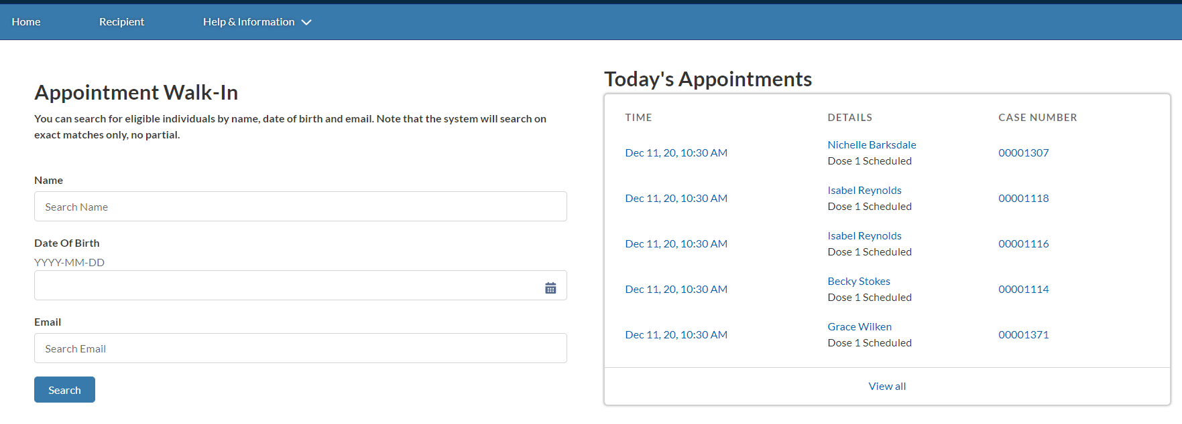
Step 6 of 6: Review the Appointment Booking
The appointment that is created will be available to you under TODAY’S APPOINTMENTS.
To begin the VACCINE ADMINISTRATION process, the recipient will require an APPOINTMENT BOOKING.
Tasks
Confirm the appointment booking is created
Tips
Confirm the appointment booking is created for the recipient before administering the vaccine
Audience
Healthcare Provider
Healthcare Location Manager

Slide 15
Appendix

Slide 16
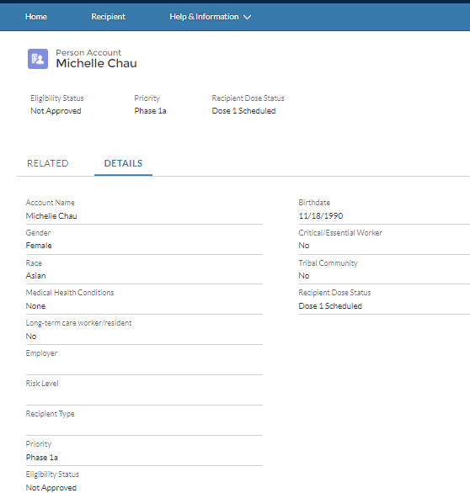
When the recipient is NOT Eligible for the Vaccine
When you verify RECIPIENT ELIGIBILITY, and the recipient is NOT APPROVED, you will need to inform the recipient that they will not be able to receive the vaccine at that time. ​
Tips:
You can review the recipient’s the Health Questionnaire Responses on the Recipient Record
A recipient is NOT ELIGIBIBLE to receive the vaccine if:
The do not have a registered CVMS Recipient Portal account
They are not approved to receive the vaccine
If the recipient informs you that their health information is NOT CORRECT, ask the recipient to UPDATE their recipient data in the RECIPIENT PORTAL.
You will NOT be able to EDIT the recipient’s profile.
From the home page, go to the RECIPIENT TAB
Search for the recipient in the ALL RECIPIENTS LIST VIEW
Click the RECIPIENT NAME
Click on DETAILS
Audience
Healthcare Provider
Healthcare Location Manager

Slide 17
Additional Notes
Key Items:
Hyperlinks appear as light blue and will provide additional information or navigation.
* Asterisks are used to denote required information.
A Toggle can be clicked to see selectable options.
A Pen can be clicked to make edits to the field.
Navigation Buttons can be clicked on to progress to the “next” or the “previous” step in a task.
A Pause button can be clicked if you wish to step away / and return to your form later. You will be prompted to review your previously entered data upon your return/ login.
Contact Information:
All questions should be directed to CVMS-help@dhhs.nc.gov.
Supported Web Browsers:
Please use the latest version of Chrome, Firefox or Safari to use this tool.
https://help.salesforce.com/articleView?id=getstart_browsers_sfx.htm&type=5
Note, Internet Explorer and Edge (Non-Chromium) will not be supported beginning January 2021.

