Slide 1
CVMS Provider Portal Viewing Proof of Vaccination User Guide
Version 1.0
December 10, 2020

Slide 2
If you have any questions, please submit all inquiries to:
CVMS-Help@dhhs.nc.gov

Slide 3
Table of Contents
Pages
Proof of Vaccination Overview and Process | 4 – 6
Locate Proof of Vaccination | 7 - 10
Appendix | 11 - 12

Slide 4
Process Overview

Slide 5
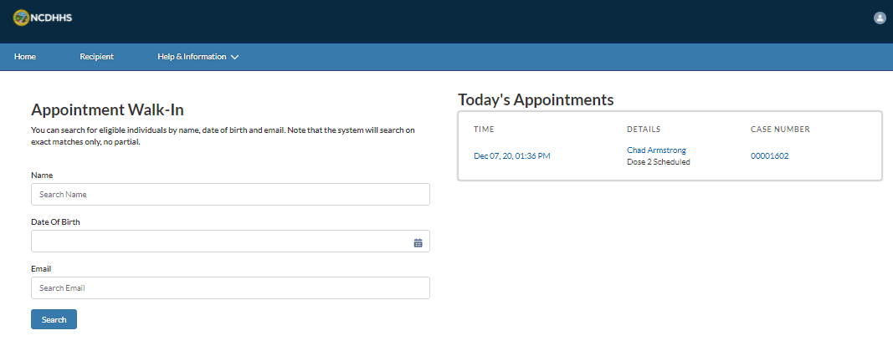
Overview
The COVID-19 Proof of Vaccination serves as verification of the COVID-19 vaccine dose(s) the recipient has received.
In addition to indicating the number of COVID-19 vaccine doses a recipient has received, it will also indicate the number of doses that may still be required.
This guide is intended for the Healthcare Location Manager and Healthcare Provider profiles.
Note that recipients may access their Proof of Vaccination in the CVMS Recipient Portal.
Additionally, you will need to:
Use the latest version of Chrome, Firefox, or Safari (Internet Explore will not be supported), and
Log into your CVMS account
Now, let’s get started!

Slide 6
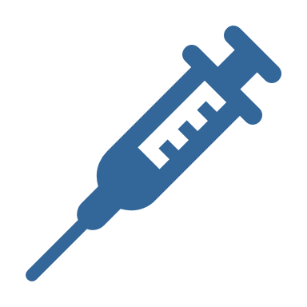
Key Terms
Proof of Vaccination is a document provided by NC DHHS to confirm that a vaccine recipient has received COVID-19 vaccines.
Proof of Vaccination
Number of doses indicates the number of vaccine doses that an individual has received. For COVID-19 vaccines, the number of doses received by a vaccine recipient could be one or two.
Number of
Doses

Slide 7
View Proof of Vaccination for a Recipient
After vaccination, how do you locate proof that a recipient has received a COVID-19 vaccination?

Slide 8
Step 1 of 3: Search for the Recipient
To get started, navigate to the RECIPIENT TAB
Click the RECIPIENT tab which is the second tab found in the top navigation bar
Type your recipient’s name in the search bar and press enter
Click your recipient’s name from the list to open the recipient’s account
Tasks
Search for recipient by name to open the recipient account page
Tips
Obtain recipient name before searching
Audience
Healthcare Provider
Healthcare Location Manager

Slide 9
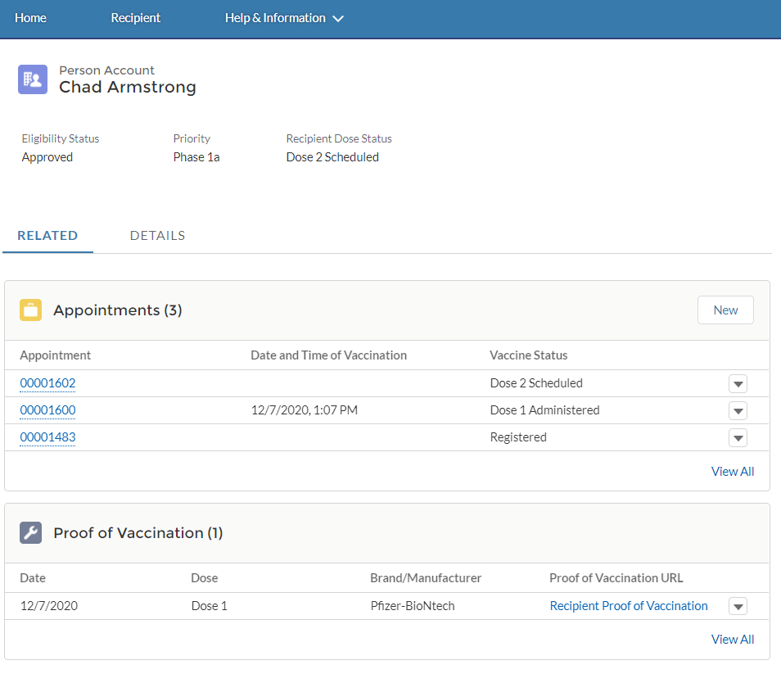
Step 2 of 3: Open the Proof of Vaccination
After CLICKING THE RECPIENT’S NAME, their PERSON ACCOUNT PAGE DISPLAYS. Information about the recipient appears here.
Make sure you are on the RELATED TAB
To view the proof of vaccination, NAVIGATE TO THE PROOF OF VACCINATION and click RECIPIENT PROOF OF Vaccination
The PROOF OF Vaccination opens in a NEW TAB
Dose indicates if the recipient has received one or two doses of the COVID-19 vaccine.
Note: If the Proof of Vaccination is empty, the recipient has not received any doses of the COVID-19 vaccine.
Tasks
Access proof of vaccination from recipient’s account page
Tips
Locate the Related Tab to view the proof of vaccination
Audience
Healthcare Provider
Healthcare Location Manager

Slide 10
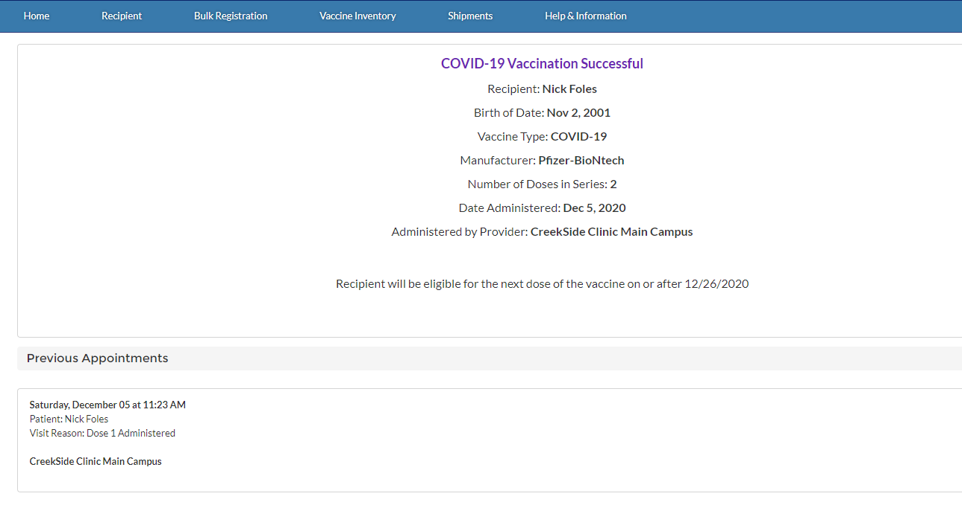
Step 3 of 3: View the Proof of Vaccination
After clicking the URL, Proof of Vaccination opens in a new tab
If needed, you may print the Proof of Vaccination using your browser’s print option
Proof of Vaccination indicates if a recipient requires additional doses and when
Tasks
View and print proof of vaccination
Tips
You may print the proof of vaccination using your browser's print option if needed
Audience
Healthcare Provider
Healthcare Location Manager

Slide 11
Appendix

Slide 12
Additional Notes
Key Items:
Hyperlinks appear as light blue and will provide additional information or navigation.
* Asterisks are used to denote required information.
A Toggle can be clicked to see selectable options.
A Pen can be clicked to make edits to the field.
Navigation Buttons can be clicked on to progress to the “next” or the “previous” step in a task.
A Pause button can be clicked if you wish to step away / and return to your form later. You will be prompted to review your previously entered data upon your return/ login.
Contact Information:
All questions should be directed to CVMS-Help@dhhs.nc.gov.
Supported Web Browsers:
Please use the latest version of Chrome, Firefox or Safari to use this tool.
https://help.salesforce.com/articleView?id=getstart_browsers_sfx.htm&type=5
Note, Internet Explorer and Edge (Non-Chromium) will not be supported beginning January 2021.

