Slide 1
CVMS Provider Portal Inventory Wastage, Return & Transfer User Guide
Version 1.0
December 10, 2020

Slide 2
If you have any questions, please submit all inquiries to:
CVMS-Help@dhhs.nc.gov

Slide 3
Table of Contents
Pages
Vaccine Wastage, Returns & Transfers Process Overview | 4 - 7
Vaccine Inventory Wastage | 8 - 13
Vaccine Inventory Returns to Manufacturer | 14 - 19
Vaccine Inventory Transfers – Primary Location | 20 - 27
Vaccine Inventory Transfers – Secondary Location | 28 - 32
Appendix | 33 - 34

Slide 4
Vaccine Wastage, Returns & Transfers
Process Overview

Slide 5
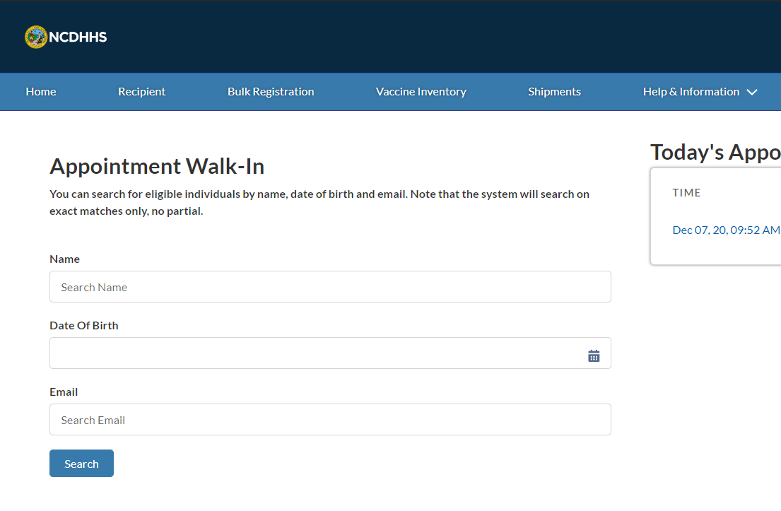
Overview
Vaccine inventory reductions, or deprecations, typically involve:
Documenting vaccine inventory wastage,
Documenting vaccine inventory returns to manufacturer, and
Understanding the vaccine transfer process
The processes discussed in this training guide are primarily for the Healthcare Location Managers profile.
You will also need to:
Use the latest version of Chrome, Firefox, or Safari
Log into your CVMS account
Now, let’s get started!

Slide 6
Key Terms
Wastage
Vaccine wastage is the sum of vaccines discarded, lost, damaged or destroyed.
Returns / Spoilage
Vaccine spoilage happens when a vaccine dose is no longer eligible for administration to an individual due to exposure to inappropriate conditions.
Vaccine Deprecation
Vaccine deprecation represents the process in which the amount of vaccines are reduced by the amount of vaccines administrated, wasted or returned.
Vaccine Inventory Shipment details
Vaccine inventory shipment details may include lot number, serial number, and national drug code (NDC).
Primary Location
Primary locations are the sites where vaccines are first shipped from the CDC.
Secondary Location
Secondary locations are the sites where vaccines are transferred to from primary locations, rather than the CDC.

Slide 7
CVMS Inventory Vaccine Deprecation
How will you document vaccine wastage, spoilage and transfers in the CVMS Provider Portal?
Key Objectives:
How to record vaccine wastages, vaccine returns, and vaccine transfers
1
2
3
4
When a vaccine is wasted:
Healthcare Location Manager accesses the Vaccine Wastage Survey Form, providing reason for waste and other applicable information.
Once submitted, the Healthcare Provider Location’s Total Vaccine On Hand Inventory is decreased accordingly.
When a vaccine is to be returned to manufacturer:
Healthcare Location Manager accesses the Vaccine Return Survey Form, providing reason for return and other applicable information.
Once submitted, the Healthcare Provider Location’s Total Vaccine On Hand Inventory is decreased accordingly.
.
When a vaccine is to be transferred:
Healthcare Location Manager complete a COVID-19 Vaccine Transfer Request Form, with details such as Primary Location Secondary Location, lot number, and quantity to transfer. Completed forms are submitted to the NC Immunization Brand at CVMS-help@dhhs.nc.gov
If approved, The NC Immunization Branch will initiate the transfer in CVMS. The approved transfer is reflected as an order for the Secondary Location.
The Vaccine On Hand inventory of the Primary Location is decreased. The Secondary Location has a Vaccine Inventory record auto-created, but the quantity is noted as "in transit".
When a vaccine transfer is received:
Secondary Location completes "Inbound Transfer" process and the quantity is changed from "in transit" to "available“.
Audience
NC Immunization Branch
Healthcare Location Manager

Slide 8
Vaccine Inventory Wastage
How do you document vaccine inventory wastage?

Slide 9
Step 1 of 5: Navigate to the Vaccine Inventory tab
To comply with the CDC’s vaccine inventory management guidelines, you will want to document ALL CASES of COVID-19 VACCINE WASTAGE in the CVMS Provider Portal. Accurately tracking vaccine wastage will also help you maintain an accurate view of vaccine inventory levels for the location(s) that you support.
Remember, examples of vaccine wastage include breaking vial/syringe and lost vaccines.
At the top of your home page, locate the tab VACCINE INVENTORY
Click VACCINE INVENTORY
After clicking VACCINE INVENTORY, you will be directed to the VACCINE INVENTORY TAB
Tasks
Locate the vaccine inventory tab
Tips
Your home page will be your one-stop-shop for navigating the CVMS Provider Portal
Audience
Healthcare Location Manager

Slide 10
Step 2 of 5: Open the Vaccine Wastage Survey form
At the top of the page, you will see the different actions you can take to manage your vaccine inventory. The ALL VACCINES LIST VIEW will be displayed by default to help you review your vaccine inventory.
Click WASTE at the top of the page
After clicking WASTE, you will be directed to the VACCINE WASTAGE SURVEY FORM
Tasks
Navigate to the Vaccine Wastage Survey form
Tips
You can use the All Vaccine Inventories List View to find a specific vaccine inventory record
To see more details for a specific vaccine record, click the Vaccine Inventory Hyperlink
Audience
Healthcare Location Manager

Slide 11
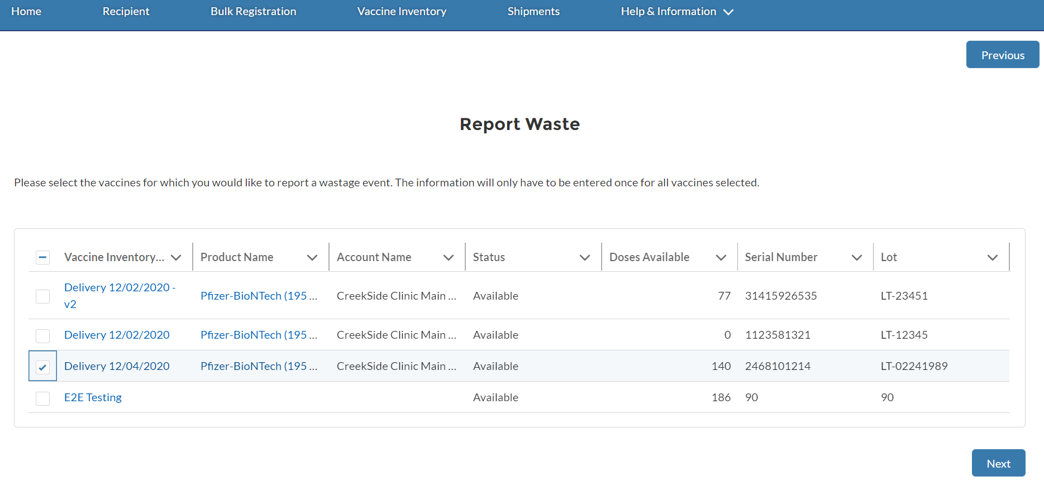
Step 3 of 5: Select the Correct Vaccine Inventory
On this page, you will be directed to select ONE OR MORE vaccine inventory records to report waste. At the bottom, you will see ALL WASTAGE EVENTS displaying all previously recorded vaccine inventory waste.
Check the BOX for the APPROPRIATE ROW(S)
Click NEXT at the bottom of the page
After clicking NEXT, you will see the VACCINE WASTAGE SURVEY FORM
Tasks
Select the applicable vaccine inventory records to report waste
Tips
You will be able to report a Partial or Full vaccine shipment wastage on the next page
Audience
Healthcare Location Manager

Slide 12
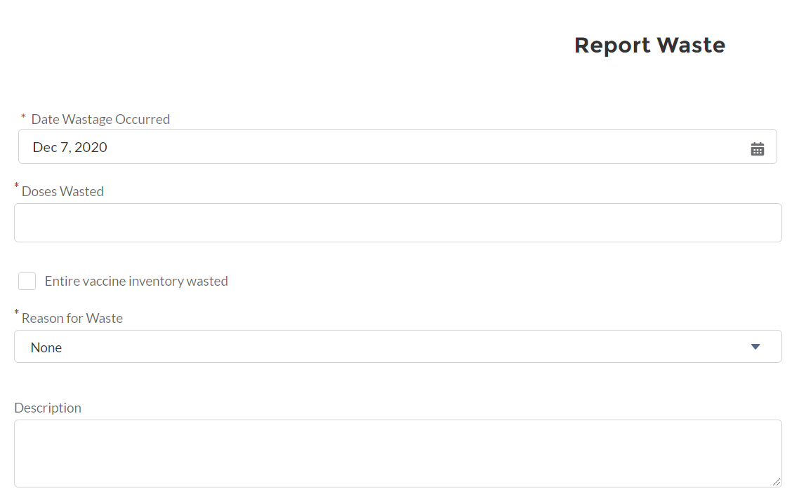
Step 4 of 5: Complete the Vaccine Wastage Survey form
Populate the required REPORT WASTE FIELDS:
Date Wastage Occurred
Doses Wasted
Reason for Waste
You may populate the OPTIONAL FIELDS if desired
Before submitting the form, CONFIRM that all entered details are correct
Once you are ready to submit the form, click NEXT
After clicking NEXT, you will be directed to the CONFIRMATION PAGE
Tasks
Populate information in the Vaccine Wastage Survey form
Tips
If you want to report the entire vaccine inventory wasted, check the Entire Vaccine Inventory Wasted Checkbox
Audience
Healthcare Location Manager

Slide 13
Step 5 of 5: Submit the Vaccine Wastage Survey form
The VACCINE WASTAGE RECORD is now submitted, and your vaccine inventory will be automatically updated.
Click FINISH
After clicking FINISH, you will be directed back to the INITIAL VACCINE WASTAGE SURVEY FORM PAGE
Tasks
Submit the Vaccine Wastage Survey form
Tips
After clicking FINISH, you will see your vaccine wastage record displayed on the All Wastage List View
Audience
Healthcare Location Manager

Slide 14
Vaccine Inventory Returns to Manufacturer
How do you document vaccine inventory returned to the manufacturer?

Slide 15
Step 1 of 5: Navigate to the Vaccine Inventory tab
To maintain an accurate view of your location(s)’s COVID-19 vaccine inventory levels, you will want to track inventory that is RETURNED TO THE MANUFACTURER. This system process is intended ONLY for the purpose of maintaining an accurate count of your vaccine levels.
It is NOT meant to track shipping details, storage details, or any other information related to returning vaccine inventory to the manufacturer.
Remember, examples of vaccine returns / spoilage include improper storage conditions and expired vaccines.
At the top of your home page, locate the tab VACCINE INVENTORY
Click VACCINE INVENTORY
After clicking VACCINE INVENTORY, you will be directed to the VACCINE INVENTORY TAB
Tasks
Locate to the vaccine inventory tab
Tips
If you have ADDITIONAL QUESTIONS around the return to manufacturer process, please reach out to:
CVMS-help@dhhs.nc.gov
Audience
Healthcare Location Manager

Slide 16
Step 2 of 5: Open the Vaccine Return Survey form
At the top of the page, there are different actions you can take to manage vaccine inventory. The ALL VACCINES LIST VIEW will be displayed by default to help you review your vaccine inventory.
Click RETURN
After clicking RETURN, you will be directed to the VACCINE RETURN SURVEY FORM
Tasks
Navigate to the Vaccine Return Survey Form
Tips
Sort the columns to help you find the vaccine inventory
Audience
Healthcare Location Manager

Slide 17
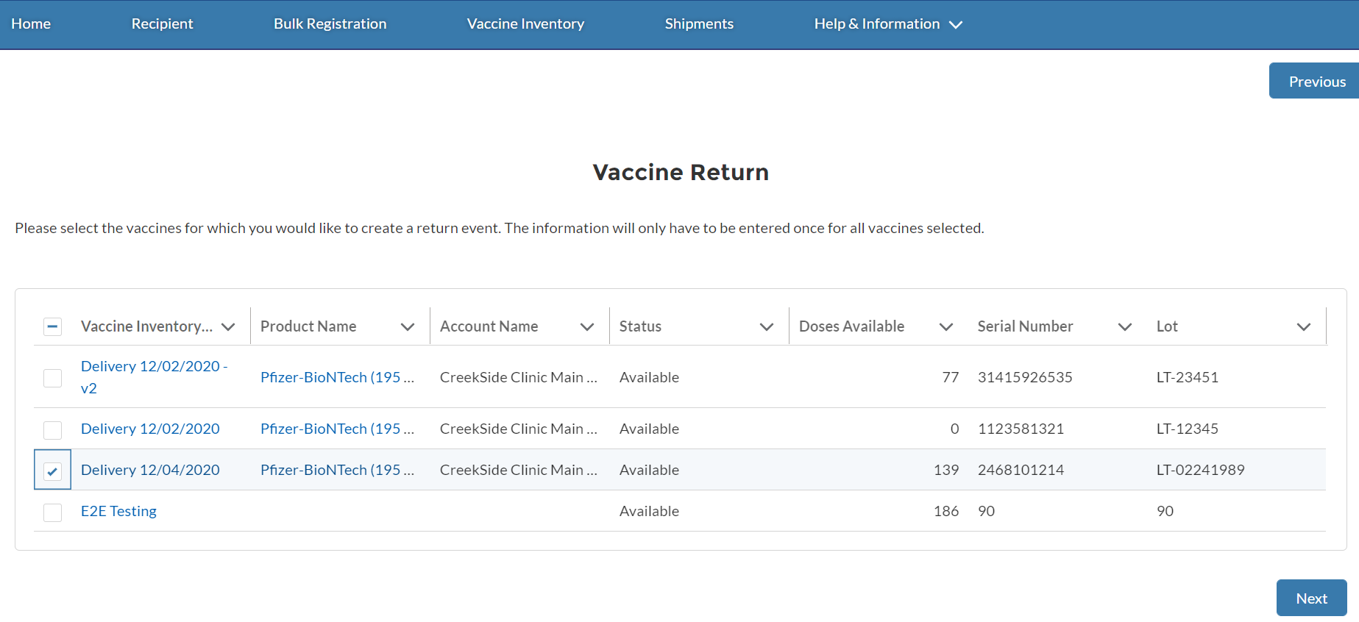
Step 3 of 5: Select the Correct Vaccine Inventory shipment
On this page, you will be directed to select ONE OR MORE vaccine inventory records to report a return. At the bottom, you will see ALL RETURN EVENTS displaying all previously recorded vaccine inventory returns.
Check the BOX for the APPROPRIATE ROW(S)
Click NEXT
After clicking NEXT, you will see the VACCINE RETURN SURVEY FORM
Tasks
Select applicable vaccine inventory records to report a return
Tips
If you want to review a past vaccine return record, scroll to the bottom of the page and click the Return ID Hyperlink
Audience
Healthcare Location Manager

Slide 18
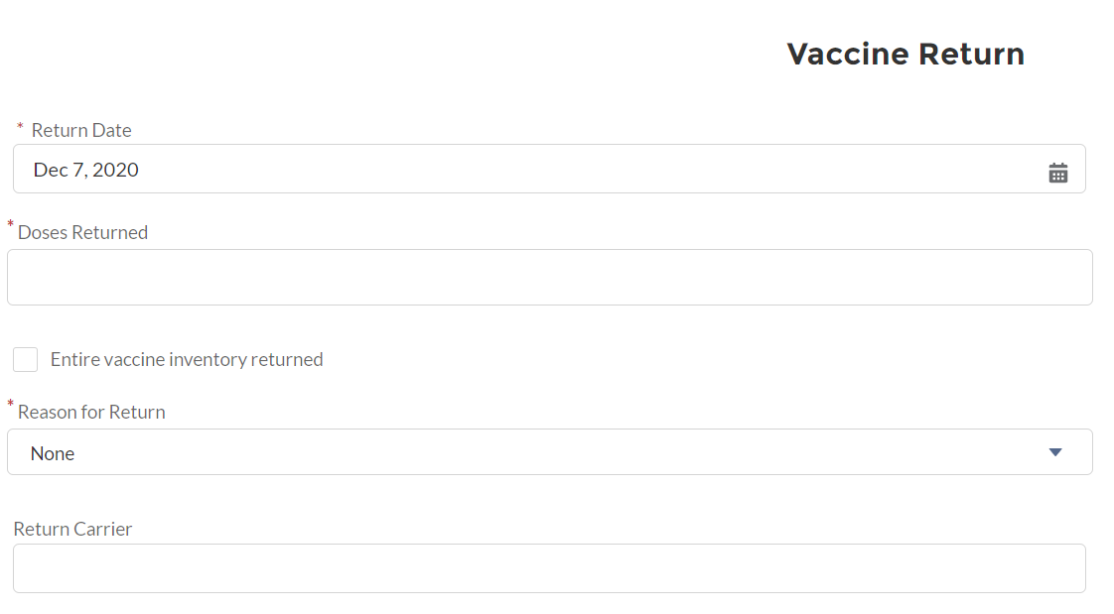
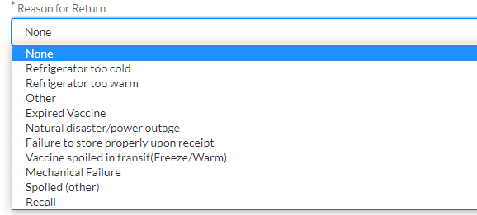
Step 4 of 5: Complete the Vaccine Return Survey form
Populate all required VACCINE RETURN FIELDS
Return Date
Doses Returned
Reason for Return
You may populate OPTIONAL FIELDS if desired
Before submitting the form, CONFIRM that all entered details are correct
Once all details are confirmed, click NEXT
After clicking NEXT, you will be directed to the CONFIRMATION PAGE
Tasks
Populate information in the Vaccine Return Survey form
Tips
If you want to report the entire vaccine inventory returned, check the Entire Vaccine Inventory Returned Checkbox
Audience
Healthcare Location Manager

Slide 19
Step 5 of 5: Submit the Vaccine Return Survey form
The VACCINE RETURN RECORD is now submitted, and your vaccine inventory will be automatically updated.
Click FINISH
After clicking FINISH, you will be directed back to the INITIAL VACCINE RETURN SURVEY FORM PAGE
Tasks
Submit the Vaccine Return Survey form
Tips
After clicking FINISH, you will see your vaccine return record displayed on the All Returns List View
Audience
Healthcare Location Manager

Slide 20
Vaccine Inventory Transfer – Primary Location
How do you initiate a vaccine transfer as a Primary Location?

Slide 21
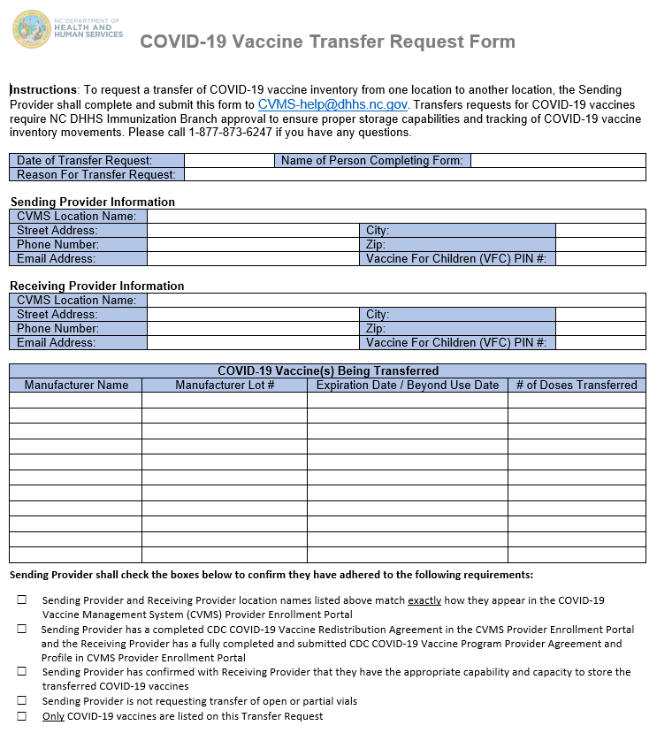
Step 1 of 7: Initiate an Outbound Transfer
To initiate an OUTBOUND TRANSFER to another location, the Primary Location will have to submit a transfer outside of the CVMS Provider Portal. Transfer requests for COVID-19 vaccines REQUIRE NC DHHS IMMUNIZATION BRANCH APPROVAL to ensure proper storage capabilities and tracking of COVID-19 vaccine inventory movements.
You will need the following details to complete COVID-19 VACCINE TRANSFER REQUEST FORM. Once the form is complete, EMAIL it to the CVMS Help Desk team at CVMS-help@dhhs.nc.gov.
If the TRANSFER REQUEST IS APPROVED, the NC DHHS Immunization Branch team will create an order transfer record and your INVENTORY WILL AUTOMATICALLY reduce by the amount transferred if approved.
Tasks
Complete the COVID-19 Vaccine Transfer Request Form. You can find the form here: https://immunize.nc.gov/
Audience
Healthcare Location Manager

Slide 22
Step 2 of 7: Tips for Completing the COVID-19 Vaccine Transfer Request Form
On the COVID-19 Vaccine Transfer Request Form, you will be asked to confirm the following items:
Sending Provider and Receiving Provider location names listed above match exactly how they appear in the COVID-19 Vaccine Management System (CVMS) Provider Enrollment Portal
Sending Provider has a completed CDC COVID-19 Vaccine Redistribution Agreement in the CVMS Provider Enrollment Portal and the Receiving Provider has a fully completed and submitted CDC COVID-19 Vaccine Program Provider Agreement and Profile in CVMS Provider Enrollment Portal
Sending Provider has confirmed with Receiving Provider that they have the appropriate capability and capacity to store the transferred COVID-19 vaccines
Sending Provider is not requesting transfer of open or partial vials
Only COVID-19 vaccines are listed on this Transfer Request
Tasks
Complete the COVID-19 Vaccine Transfer Request Form. You can find the form here: https://immunize.nc.gov/
Audience
Healthcare Location Manager

Slide 23
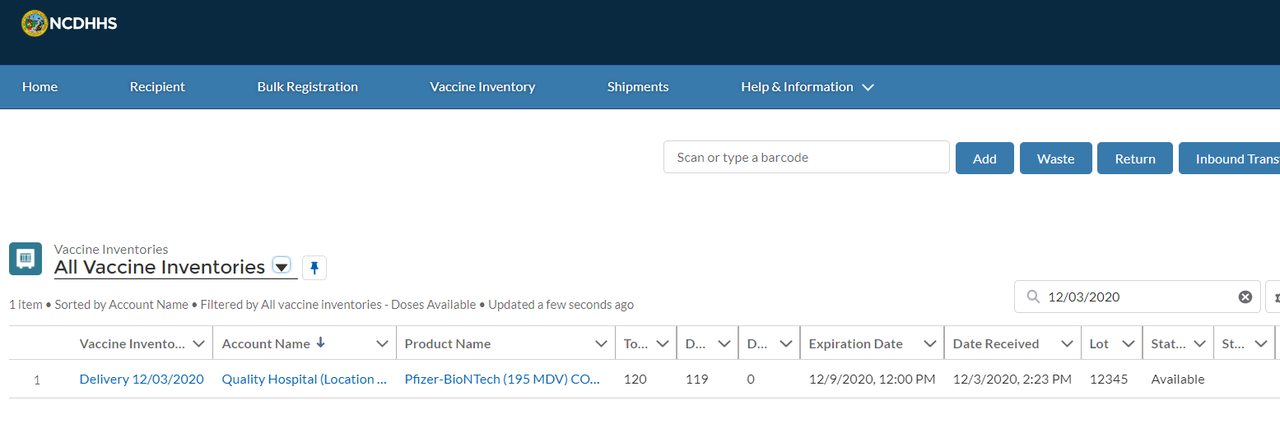
Step 3 of 7: Providing Transfer Details
Once your TRANSFER REQUEST IS APPROVED, you will be able to SHIP YOUR VACCINE INVENTORY to the Secondary Location.
You will need to UPDATE THE ORDER TRANSFER RECORD with the ACTUAL SHIPMENT DETAILS to support tracking of the shipment. The order transfer record can be located via the vaccine inventory record that is providing the inventory.
From the home page, click VACCINE INVENTORY
Search for the VACCINE INVENTORY NAME
Click the VACCINE INVENTORY NAME
Tasks
Enter shipment details during the outbound transfer process
Tips
Identify shipment date and shipment tracking information
Audience
Healthcare Location Manager

Slide 24
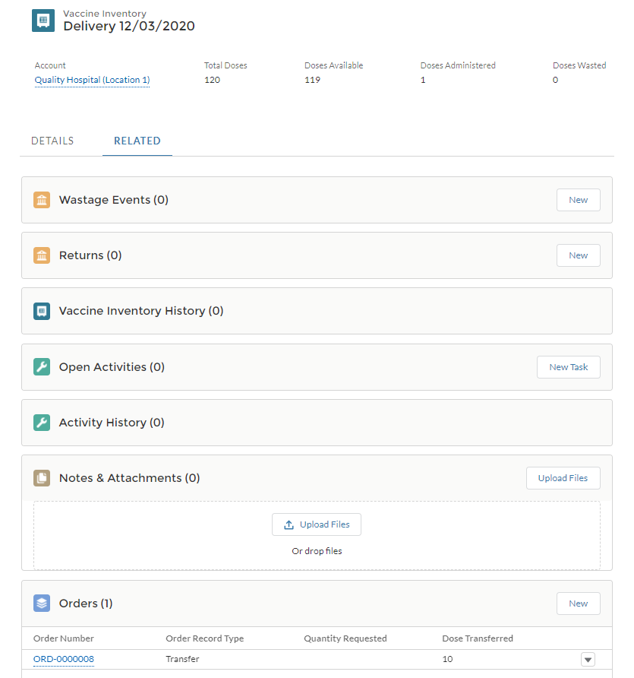
Step 4 of 7: Open the Vaccine Inventory Record
Once you are on the VACCINE INVENTORY RECORD, navigate to the RELATED TAB.
Navigate to the RELATED TAB
Tasks
Navigate to the Related Tab
Tips
Locate the Related Tab on the Vaccine Inventory Record
Audience
Healthcare Location Manager

Slide 25
Step 5 of 7: Open the Order Transfer Record
You will be able to locate the ORDER TRANSFER RECORD that was created to track the transfer. Before you edit the order transfer record, CONFIRM THAT THE RECORD TYPE IS TRANSFER.
Locate the ORDERS SECTION
Click the ORDER NUMBER for the ORDER TRANSFER
Tasks
Locate and open the Order Transfer Record
Tips
Click the order number to confirm the record type
Audience
Healthcare Location Manager

Slide 26
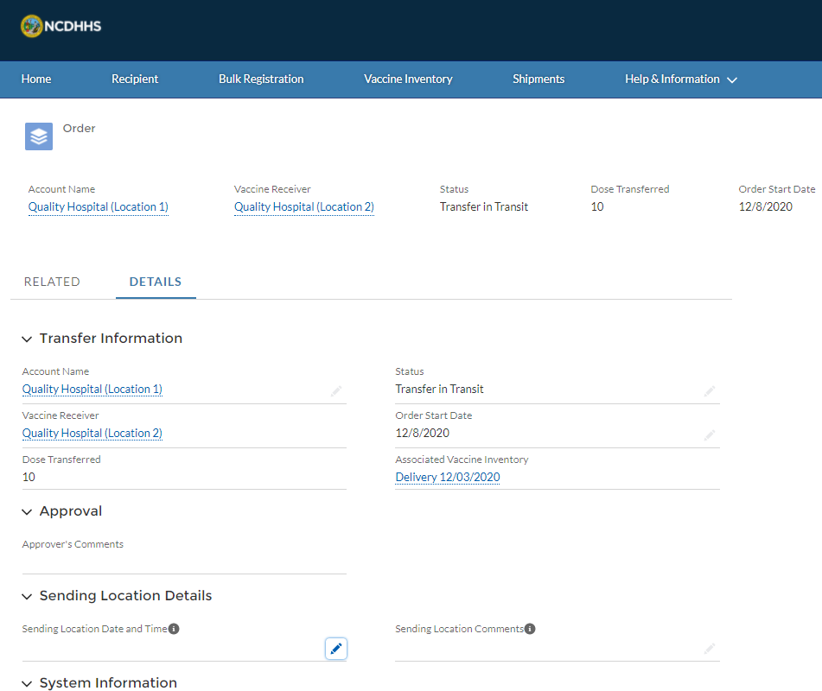
Step 6 of 7: Edit the Order Transfer Record
Once you have the ORDER TRANSFER RECORD open, you can provide the SHIPMENT DETAILS REQUIRED.
Navigate to the DETAILS SECTION
Click the PENCIL ICON next to SENDING LOCATION DATE AND TIME
Tasks
Provide the shipment details required on the order transfer record
Tips
Navigate to the details section to edit the order transfer record
Audience
Healthcare Location Manager

Slide 27
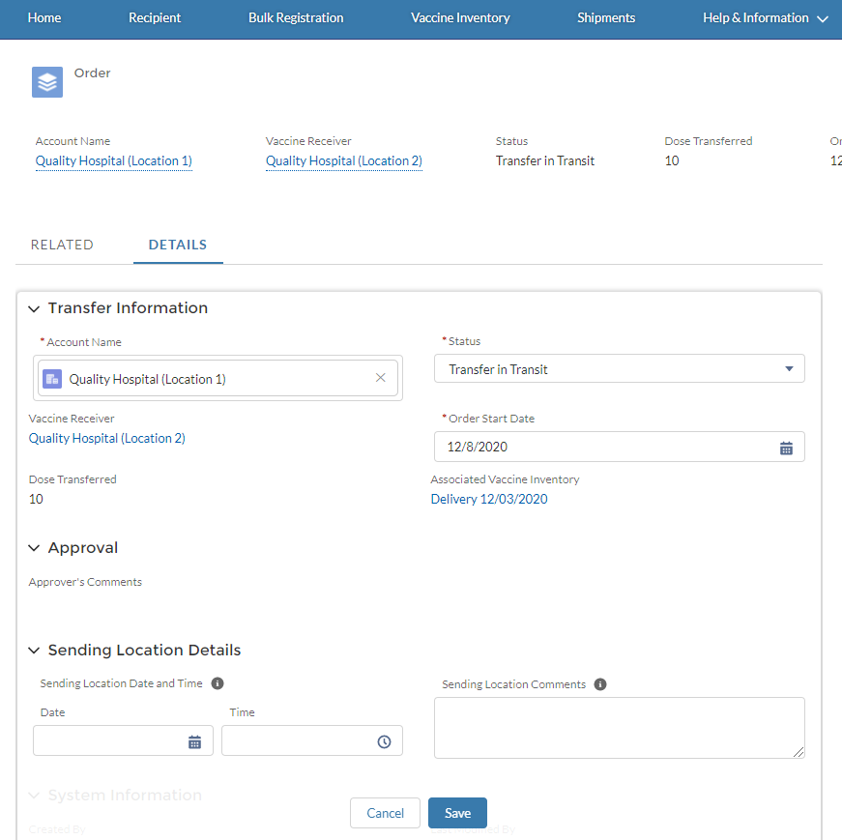
Step 7 of 7: Enter Shipment Details and Save
Once you click edit, you will be able to update the record and save your changes.
Enter the SENDING LOCATION DATE AND TIME
Enter the SHIPMENT TRACKING INFORMATION in the SENDING LOCATION COMMENTS
Click SAVE
Tasks
Update the order transfer record
Tips
Remember to save the changes after edits
Audience
Healthcare Location Manager

Slide 28
Vaccine Inventory Transfer – Secondary Location
How do you receive a vaccine transfer as a Secondary Location?

Slide 29
Step 1 of 4: Processing an Inbound Transfer
If you are RECEIVING an INBOUND TRANSFER from another location, you will want to review the inbound transfer page to stay up-to-date. When you receive the inbound transfer, you will be able to PROCESS THE INVENTORY via the INBOUND TRANSFER PAGE.
You DO NOT process inbound transfers from the ADD INVENTORY PROCESS.
From the home page, click VACCINE INVENTORY
Click INBOUND TRANSFER
Tasks
View inbound transfer
Tips
Inbound transfer is not processed from the Add Inventory Process
Audience
Healthcare Location Manager

Slide 30
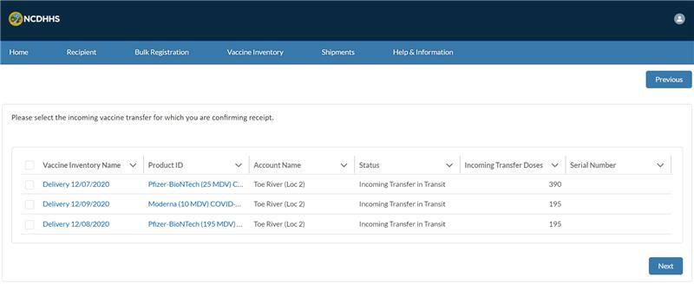
Step 2 of 4: Select the Vaccine inventory Record
On the INBOUND TRANSFER PAGE, you will see VACCINE INVENTORY records that are incoming transfers to your location. You will be able to select the inbound transfer you are ready to process and add it to your inventory.
Select the correct VACCINE INVENTORY record
Click NEXT
Tasks
Select the applicable inventory record for inbound transfer
Tips
Identify vaccine inventory records for inbound transfer
Audience
Healthcare Location Manager

Slide 31
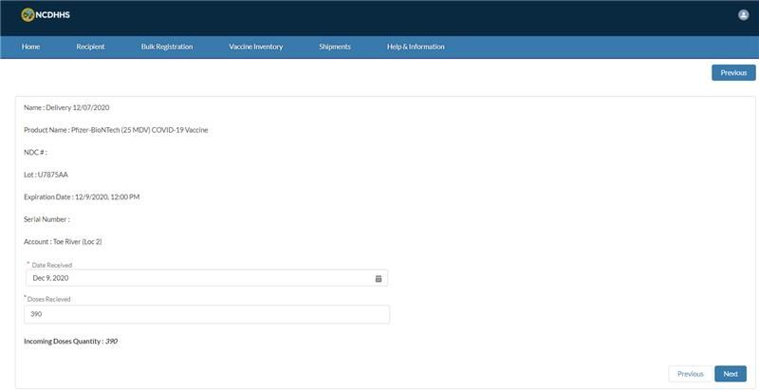
Step 3 of 4: Complete the Inbound Transfer form
Once you select the inventory, you will see the vaccine inventory details pre-populated. You will want to provide the DOSES RECEIVED and DATE RECEIVED.
After clicking next, your inventory levels will update, and the inbound transfer is now processed.
Enter the DATE RECEIVED
Enter the DOSES RECEIVED
Click NEXT
Tasks
Enter doses received and date received to process inbound transfer
Tip
Identify doses received and date received for the vaccine inventory.
Audience
Healthcare Location Manager

Slide 32
Step 4 of 4: Complete the Inbound Transfer form
After clicking next, your inbound transfer is processed and added to your inventory.
Click FINISH
Tasks
Finish inbound transfer
Tip
Complete the inbound transfer form
Audience
Healthcare Location Manager

Slide 33
Appendix

Slide 34
Additional Notes
Key Items:
Hyperlinks appear as light blue and will provide additional information or navigation.
* Asterisks are used to denote required information.
A Toggle can be clicked to see selectable options.
A Pen can be clicked to make edits to the field.
Navigation Buttons can be clicked on to progress to the “next” or the “previous” step in a task.
A Pause button can be clicked if you wish to step away / and return to your form later. You will be prompted to review your previously entered data upon your return/ login.
Contact Information:
All questions should be directed to CVMS-help@dhhs.nc.gov.
Supported Web Browsers:
Please use the latest version of Chrome, Firefox or Safari to use this tool.
https://help.salesforce.com/articleView?id=getstart_browsers_sfx.htm&type=5
Note, Internet Explorer and Edge (Non-Chromium) will not be supported beginning January 2021.

